Slide 1
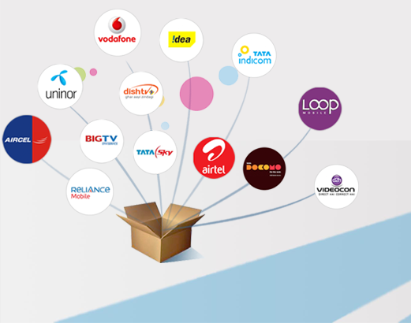
Si Online technomart private limited
Prepaid recharge, bill pay, ticketing & more

Slide 2
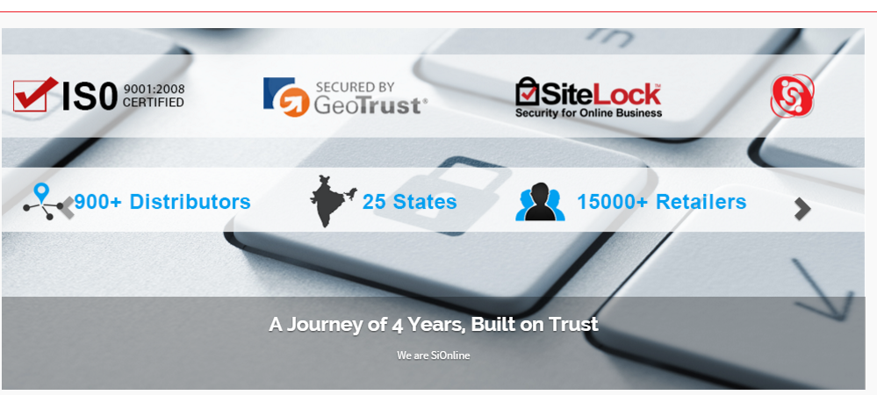
About SiOnline
A Journey of Successful 4 Years, Built on Trust
GeoTrust & Sitelock Secured, ISO 9001:2008 Certifed Company
Pan India Network of 900+ Distributors, 15000+ Retailers

Slide 3
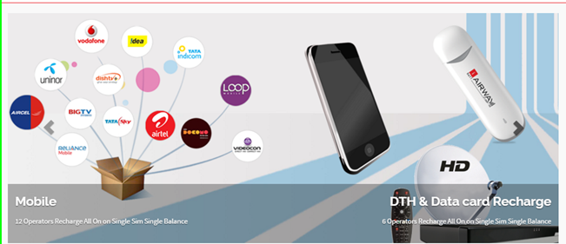
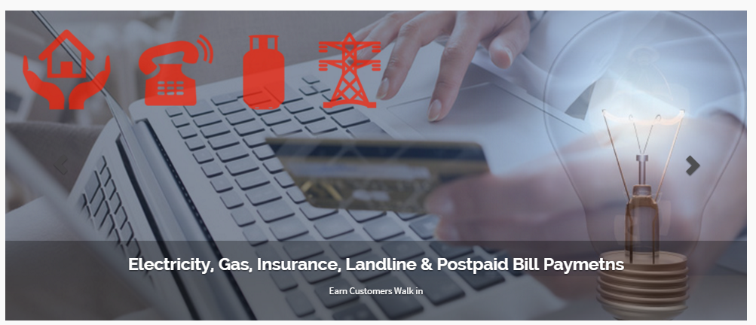
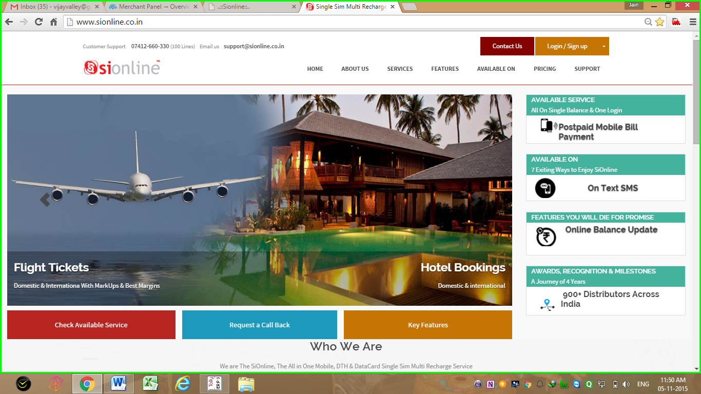
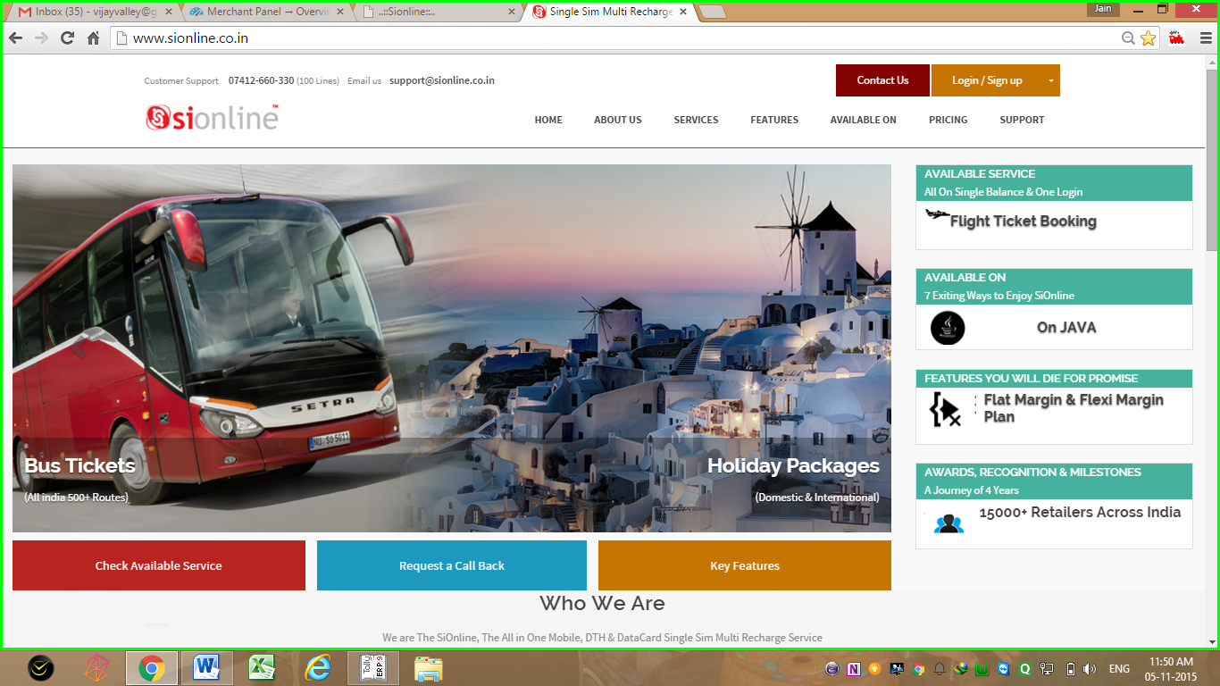
SiOnline recharge , bill pay & Travel Services
Mobile and DTH Recharge, Bill-Pay, Air Ticket, Bus ticket,
Holiday Packages, Hotel Bookings, Money Transfer

Slide 4
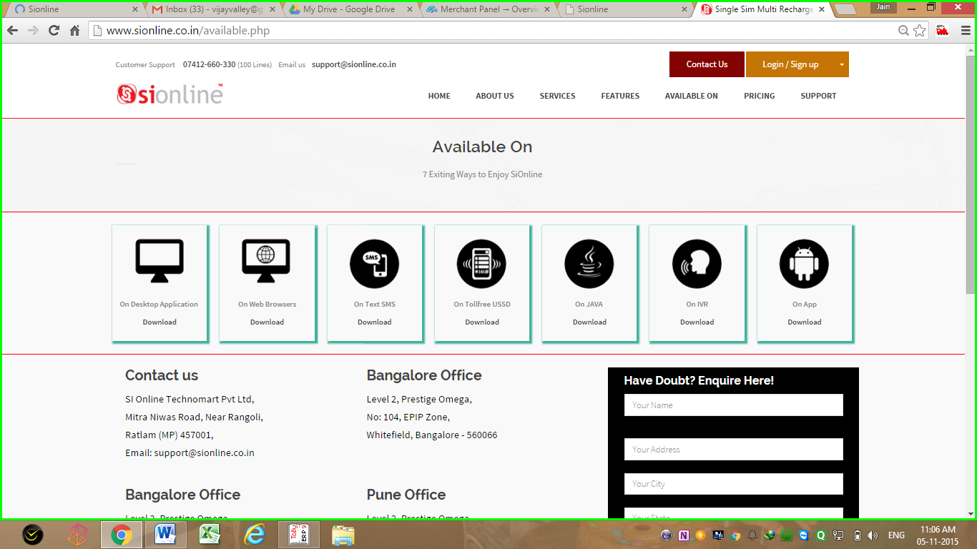
3 Exiting ways to enjoy Si Online
Available on Web Application, SMS Recharge & Android App
Also Coming Soon on Toll free USSD, IVR & JAVA APP

Slide 5
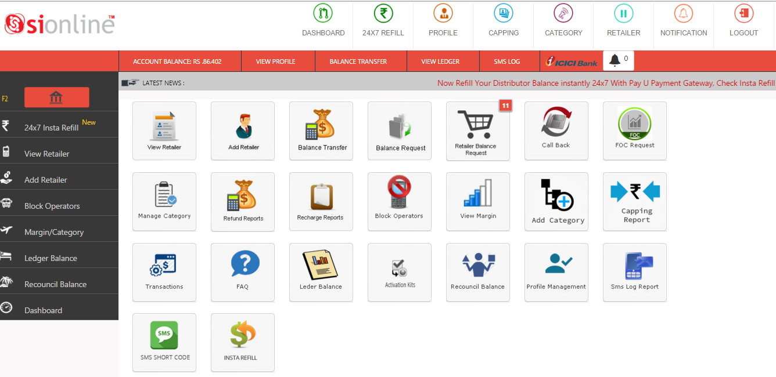
Distributor Login Dash Board

Slide 6
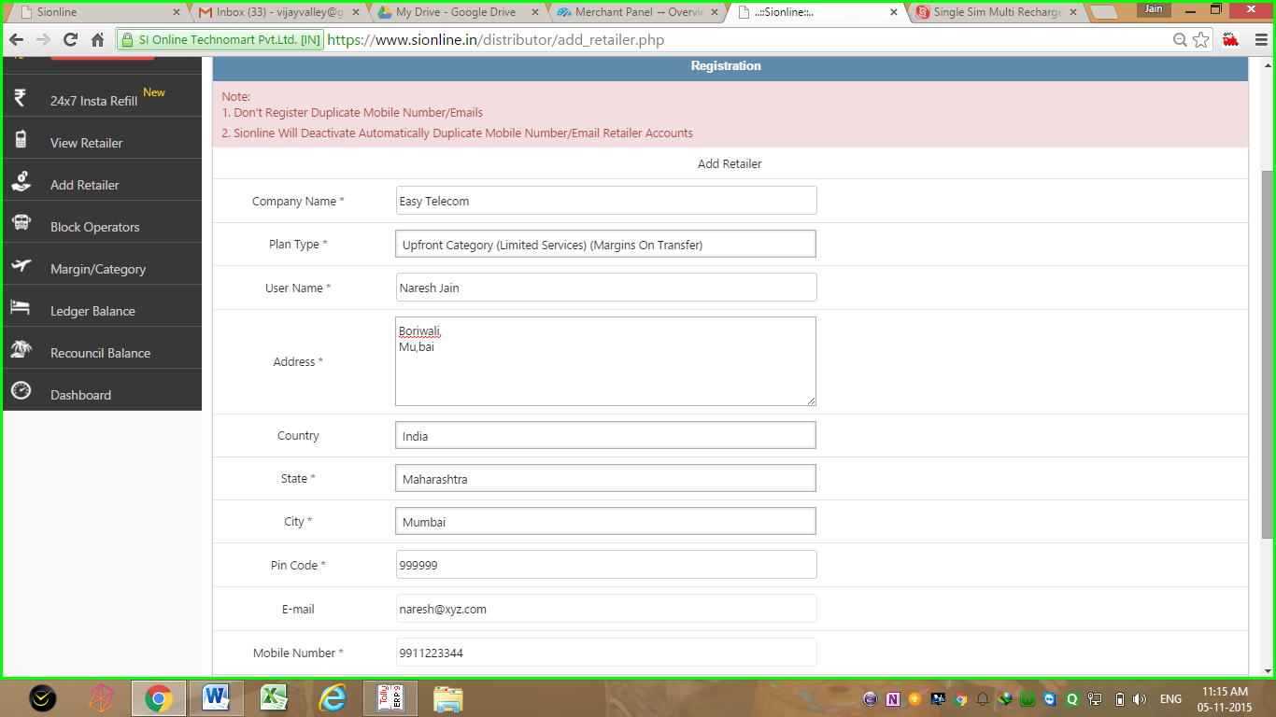
Add new retailer page in distributor Login
Simply Fill in Retailers Details & Get Activation instantly

Slide 7
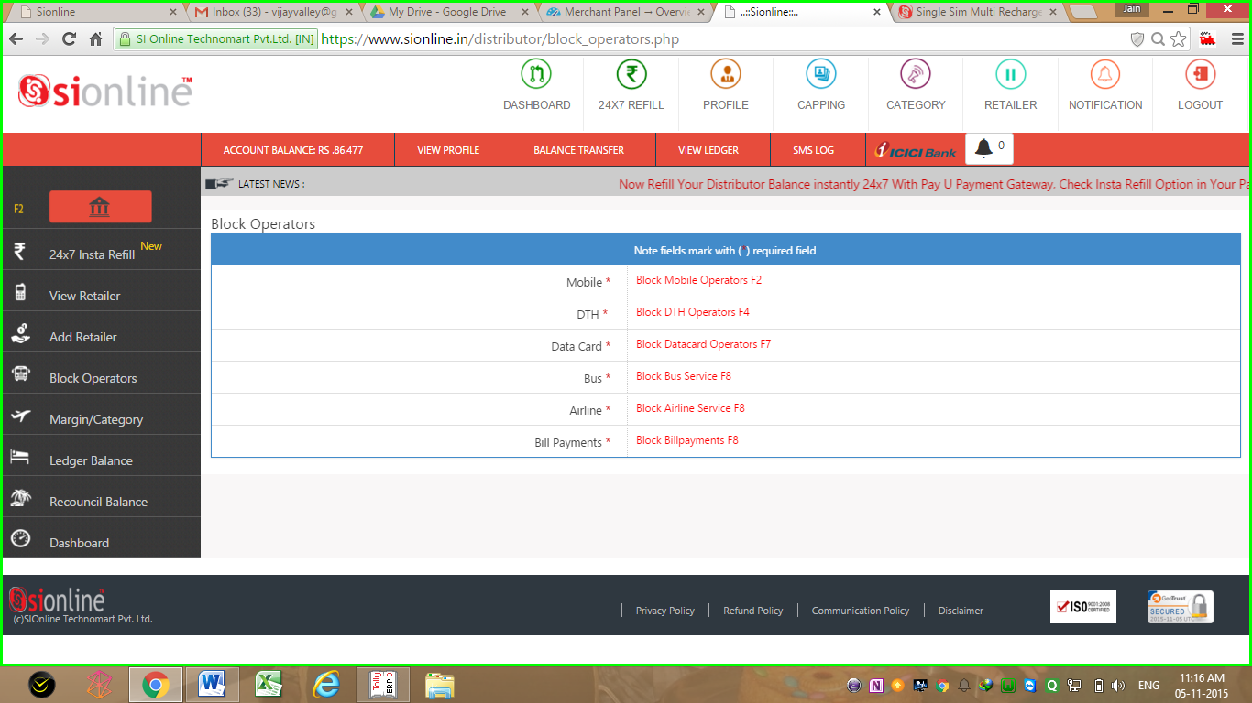
Control panel to Activate/Deactivate operators/services for your downline
You Can Choose & Block Any or All Operators Recharge for Retailers in Your Panel

Slide 8
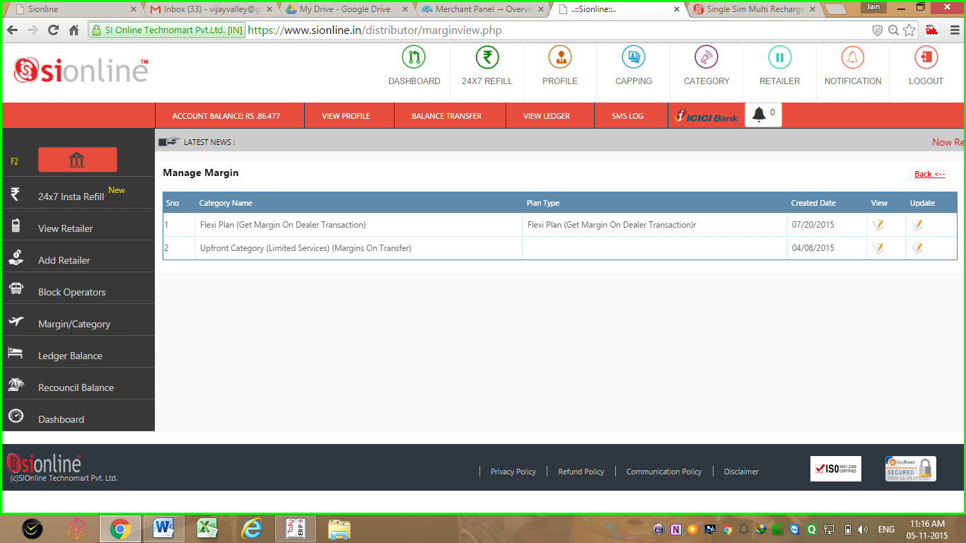
Option to choose flat or flexi margin category Plans for Your Retailers,
Both Will Be Available in Your Account.
You Can Choose Any 1 when u add Retailer

Slide 9
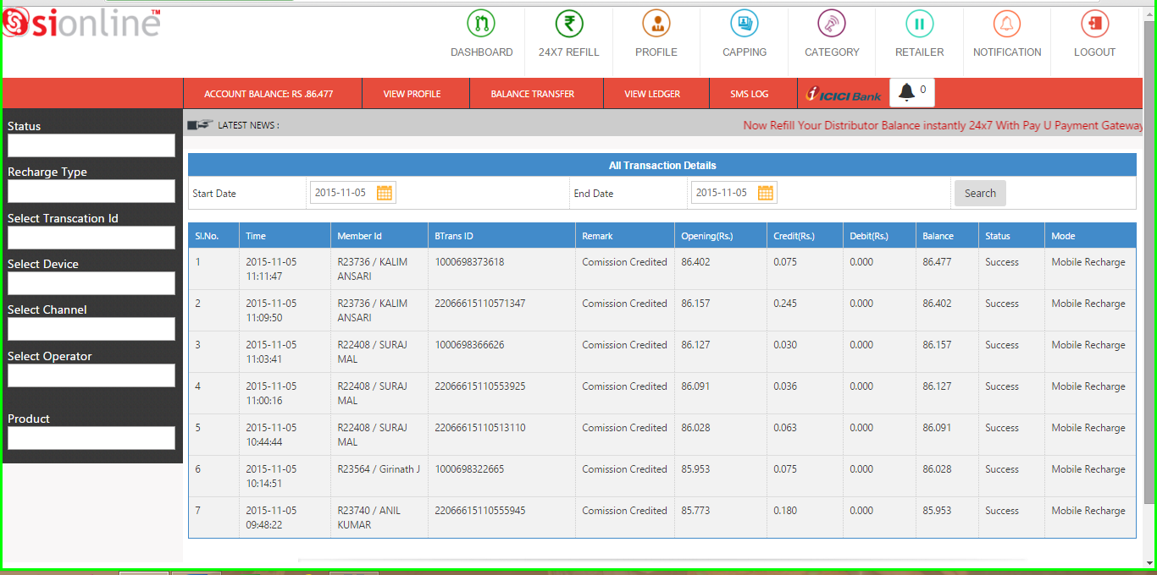
Commision & account ledger report
Check Your Daily, Weekly & Monthly Account Statements Here
With Details of Retailer ID, Commision, Opening & Closing Balance

Slide 10
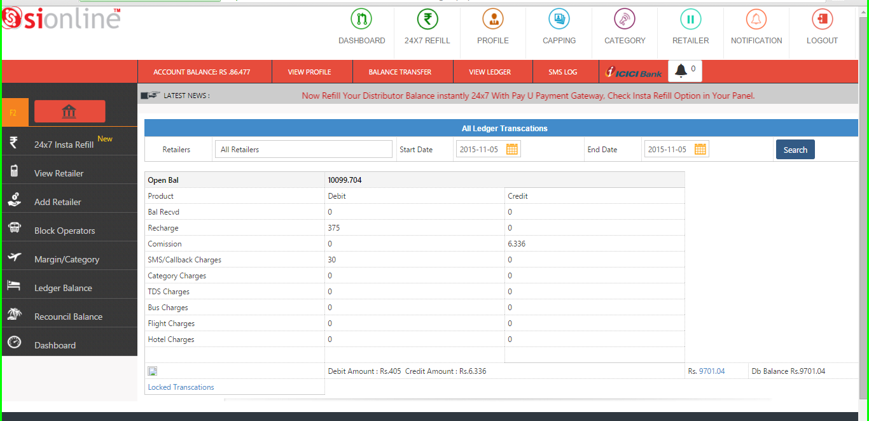
Recouncilation Report
Check Your Day/Month Wise Recouncialtion Opening & Closing Balance,
Balance Transfers, Commisions & Charges Etc. Here

Slide 11
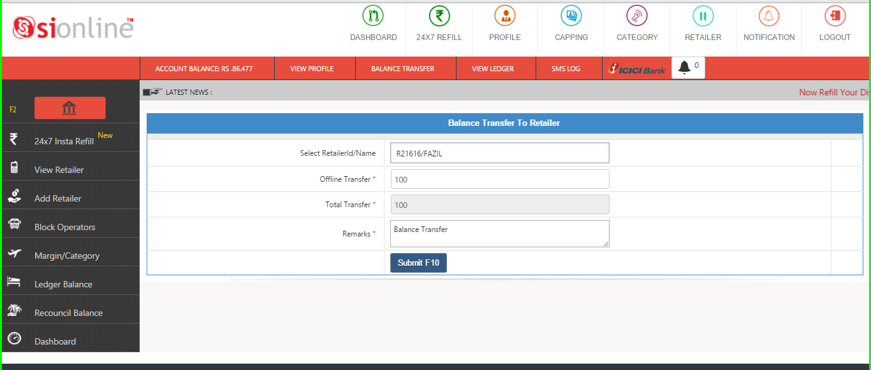
Transfer Balance to retailer page
Just Select Retailer Name & update Amount to Transfer Balance

Slide 12
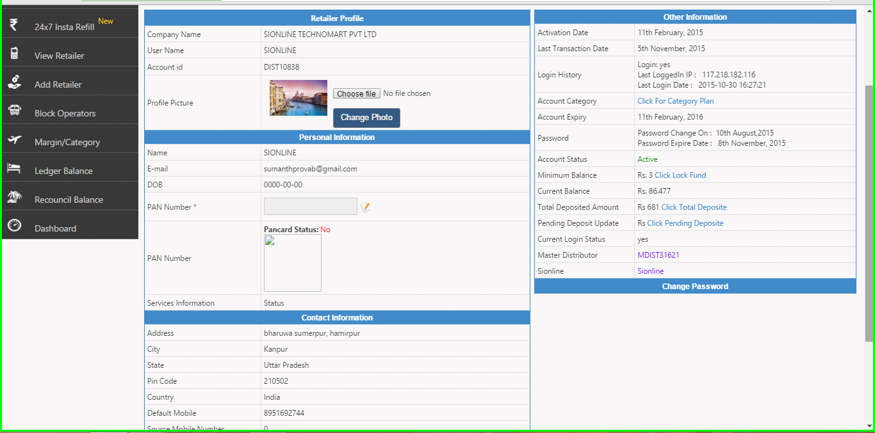
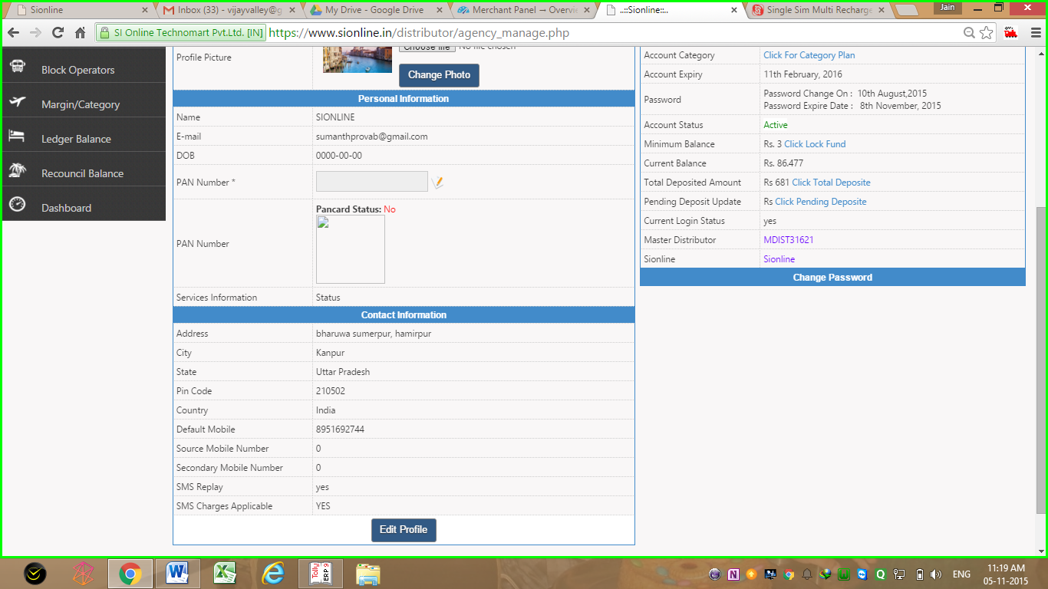
Profile management
View Your Account Details in Profile biz Date of Activation, Balance, Category, Change Mobile Number, Email ID, Update Password ETC)
Add Upto 3 Nunbers in Single Profile >>

Slide 13
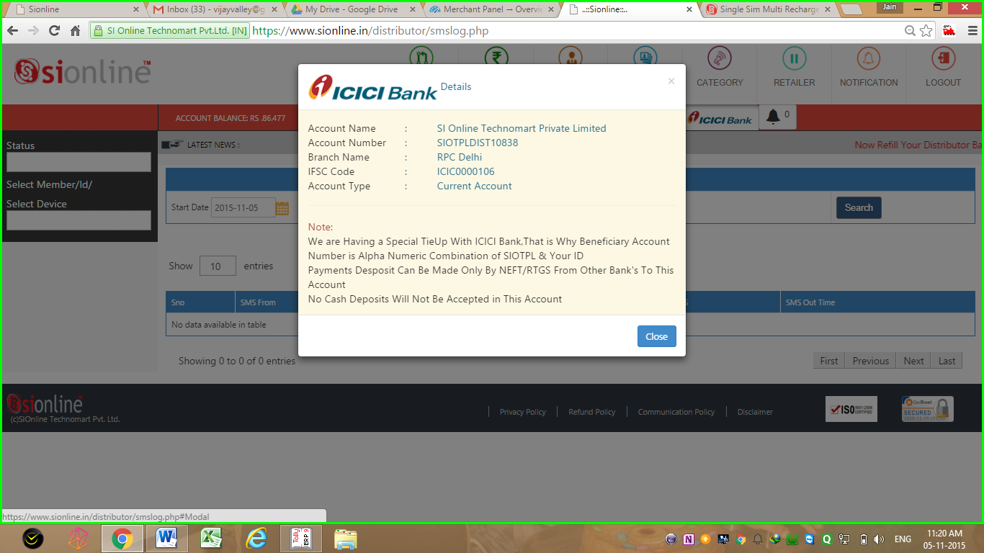
Dedicate ICICI Bank Corporate Account Creation Tie Up
for Every Retailer & Distributor Added, For Faster NEFT Balance Update

Slide 14
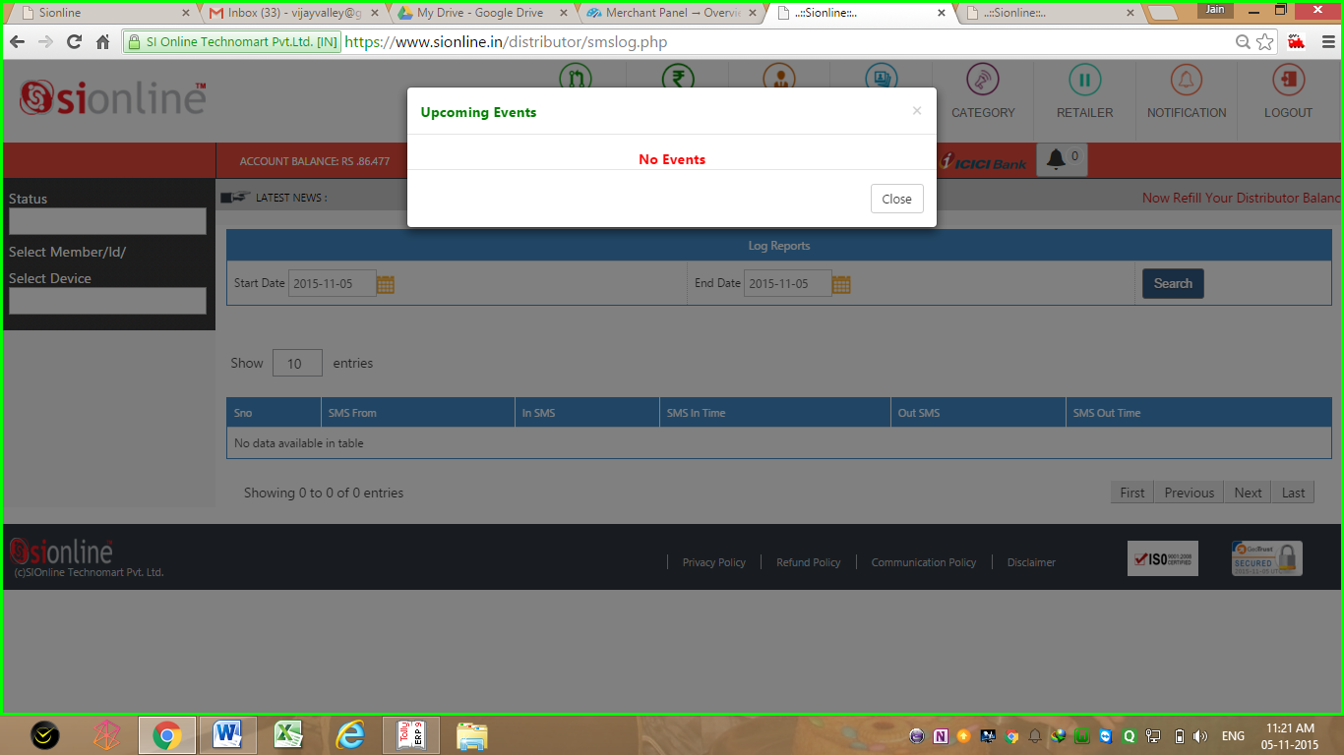
Get Details & Pre information of Upcoming Events in Your Login
Events Details fro Bank Holidays – Festivals – New Updates – Additions in Service ETC

Slide 15
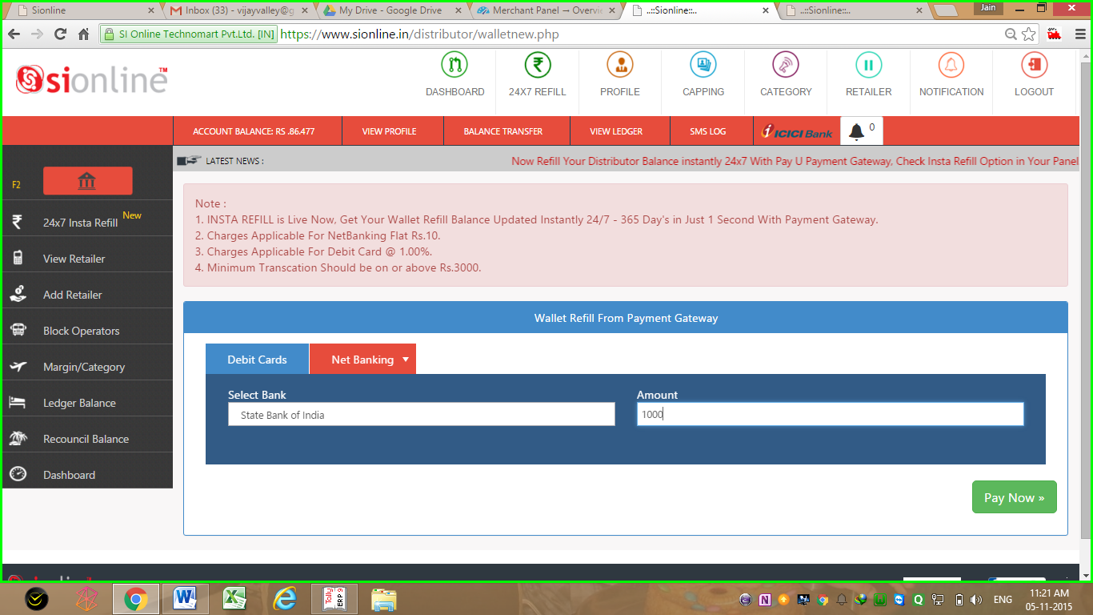
Insta Refill Option for 24x7 365 Days Balance Update
Getting Low in Balance, Nothing to Worry…
Get Your Account Balance Updated instantly, With Secured PayU Payment Gateway

Slide 16
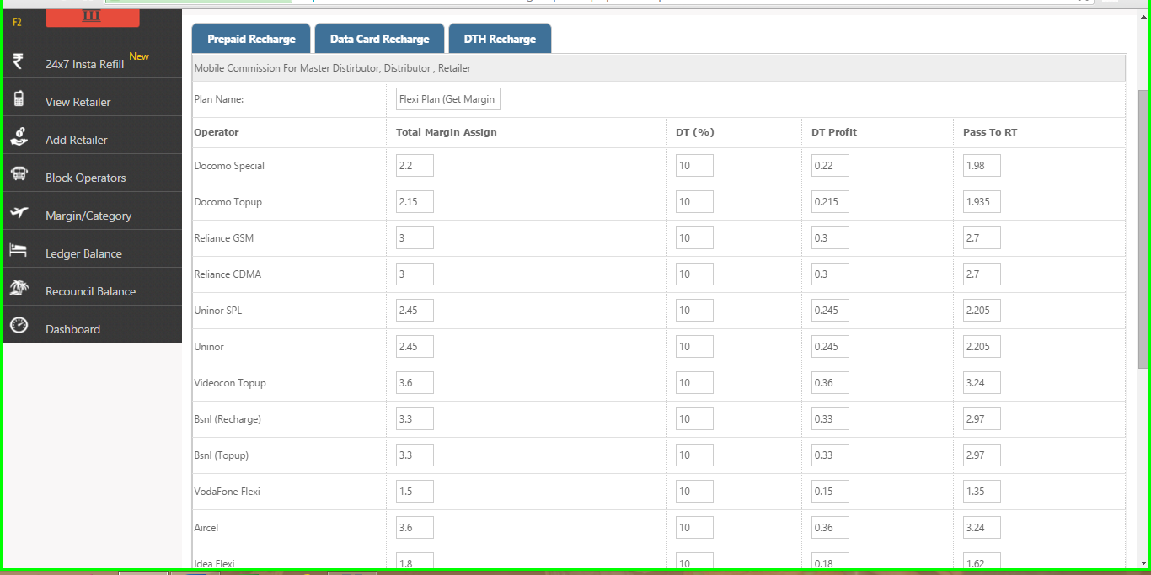
Customize your margins for recharge in flexi plan
Set Here How Much % Margin You Want to Keep & how You Want to Transfer to Retailer

Slide 17
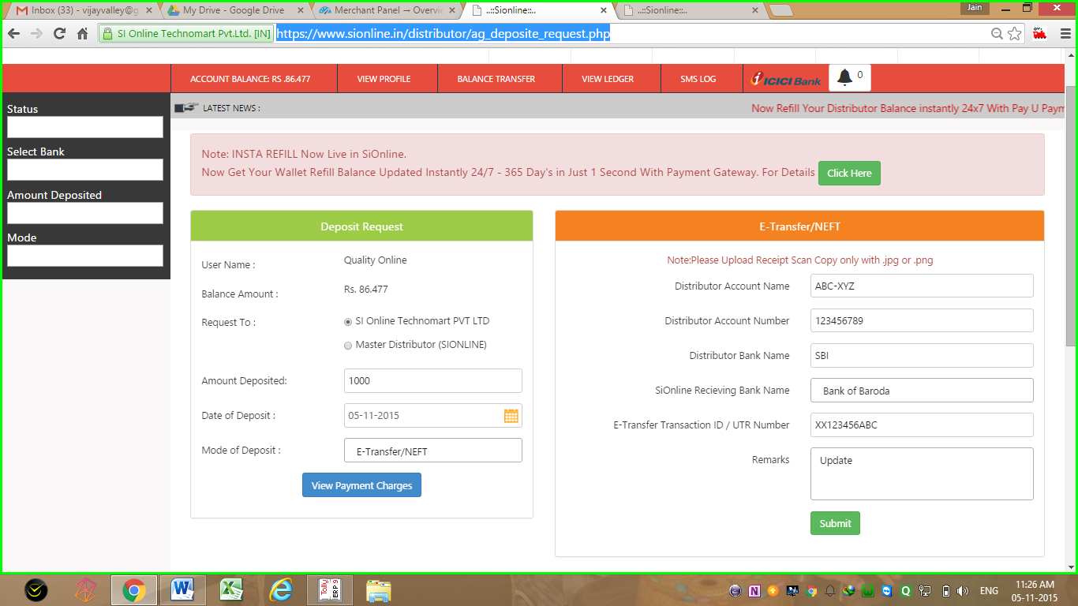
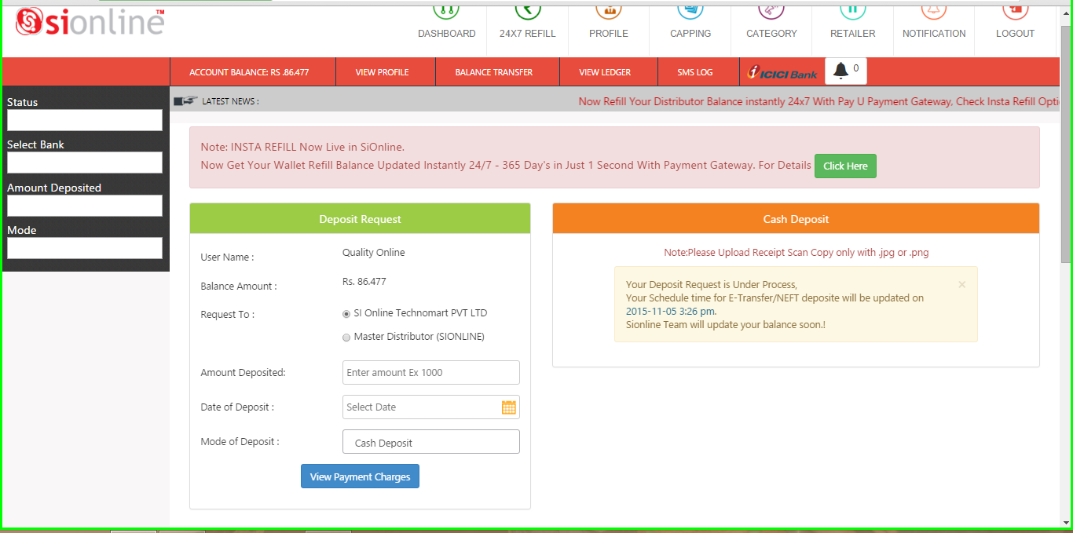
Deposit request page
No Need To Call SiOnline when you deposit payments for balance.
Just update request to get balance automatically in scheduled time.
Schedule Time Display for Estimated Update Time >>>>

Slide 18
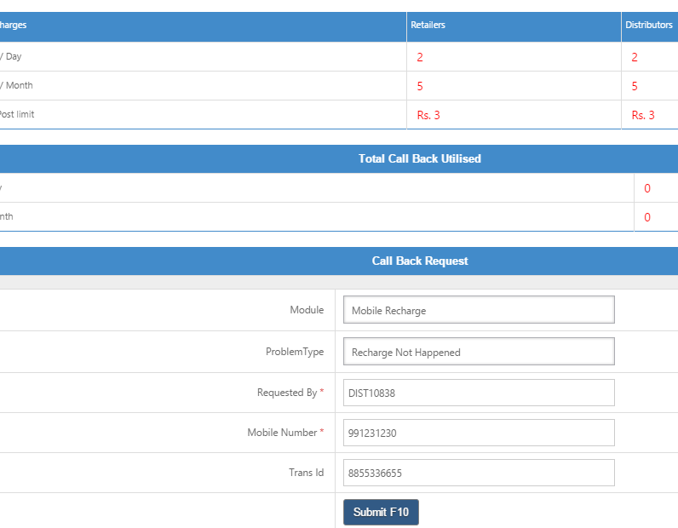
Call back request option
No Need to Waste Your Money in Calling SiOnline.
Simply Update Call Back Request & We Will Call You Back !!!!
Call Back Request Page

Slide 19
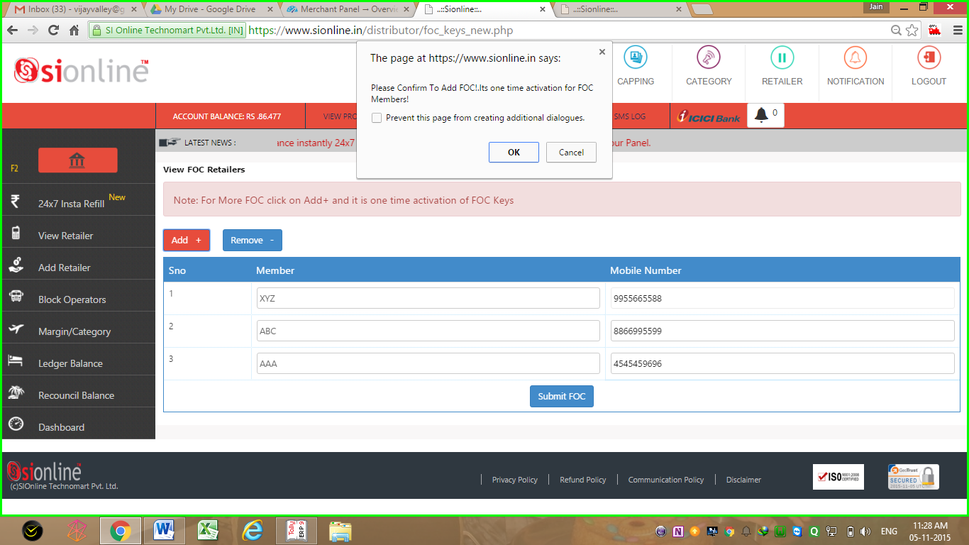
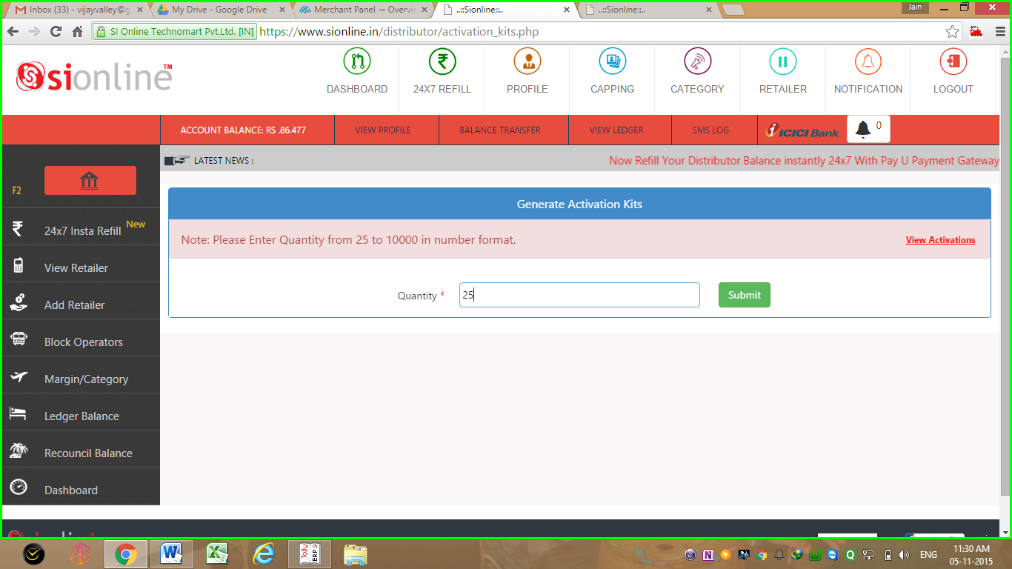
Activation pins request page
<<<<<
Free of Cost Activation Pins Request Page To Get Activation Pins F.O.C.
For Existing Retailers Only (T&C Apply)
Paid Activation Pins Request Page for New Retailers Additions >>>>

Slide 20
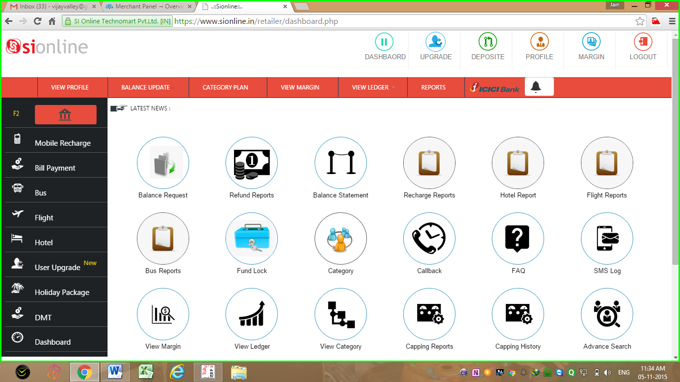
Retailer Login Dash Board

Slide 21
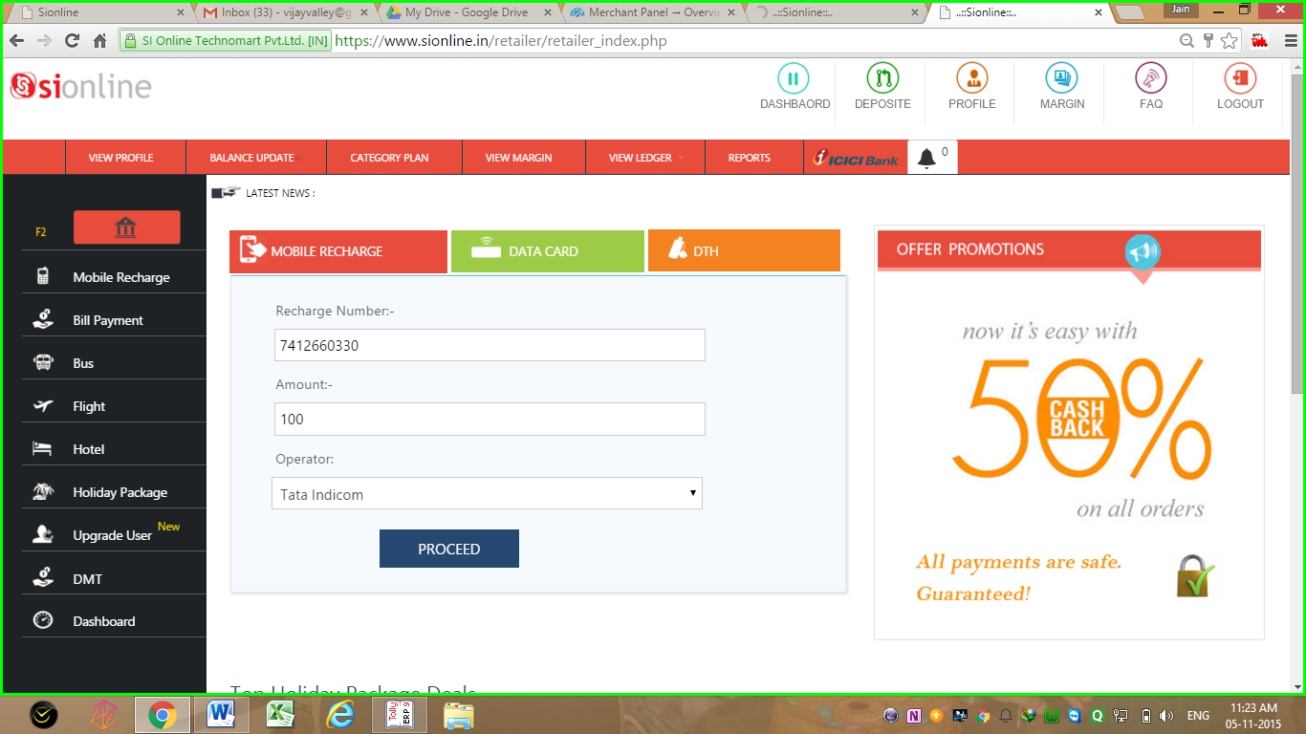
Retailer Mobile & DTH Recharge Page
Insert >> Proceed >> Confirm >> & its Done in Just 3 Seconds

Slide 22
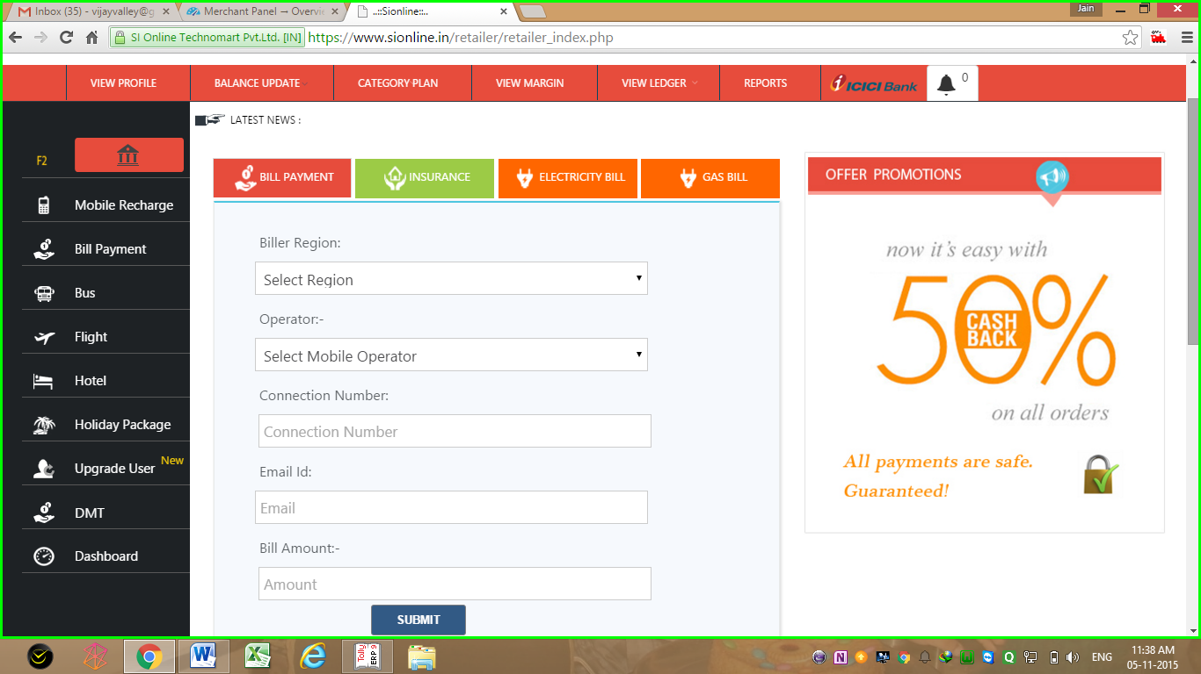
Retailer Bill Payment, Gas Bill, Electricity Bill Payment Page

Slide 23
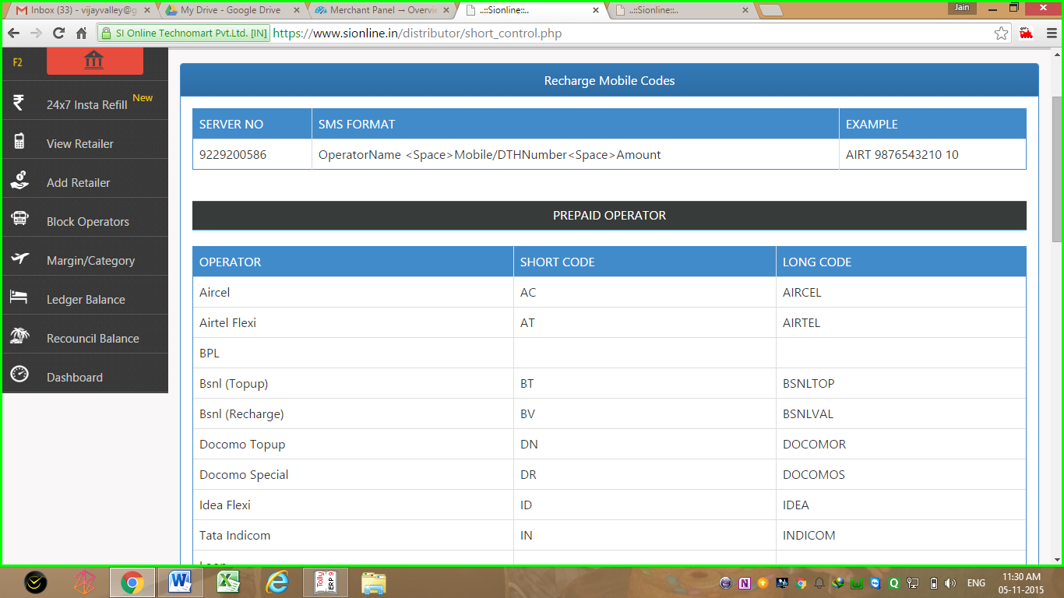
SMS Recharge syntax
Get details of operators Recharge Codes
in Your Retailer & Distributor Login Panel

Slide 24
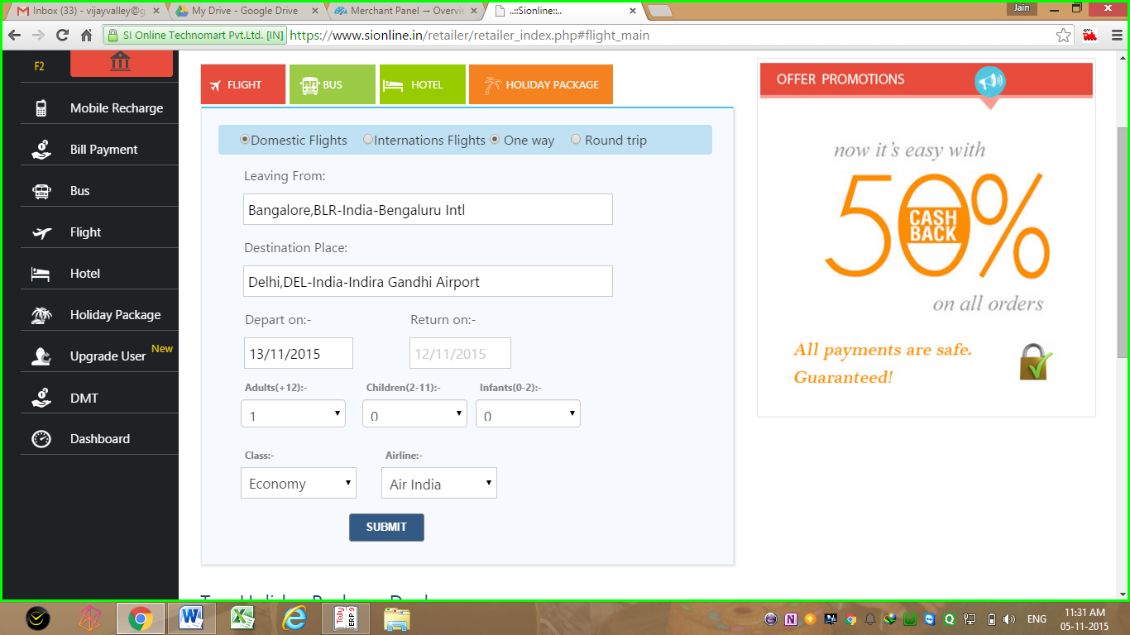
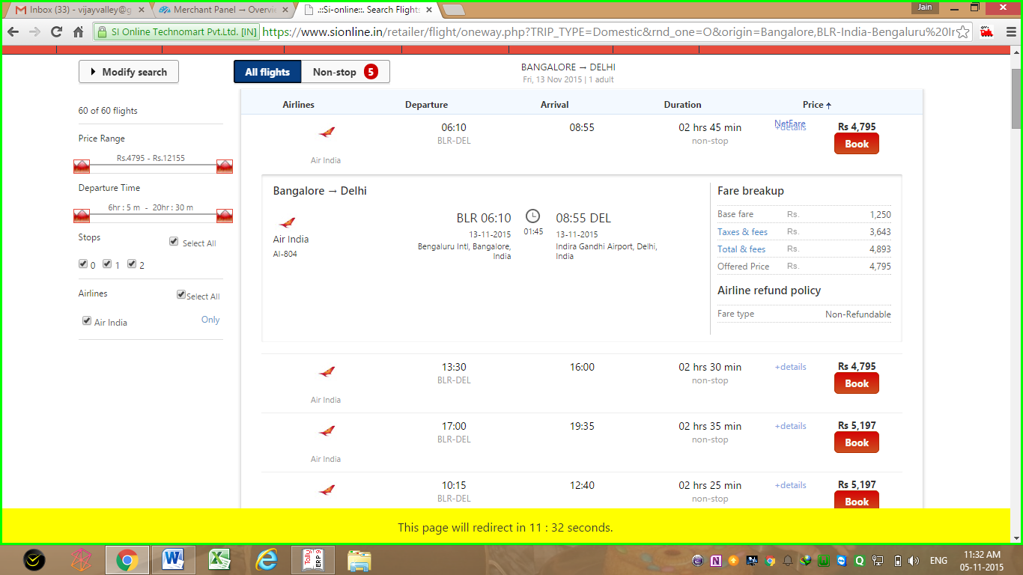
Air ticket booking page
<<< Search Air Ticket Page
Air Ticket Result Page >>>>>>
Search Domestic & international Air Ticket
Get Results for Arrival/Departure Time,
Booking & Cancellation Policy, Fares. Refine Search for Airlines, Modify , ETC

Slide 25
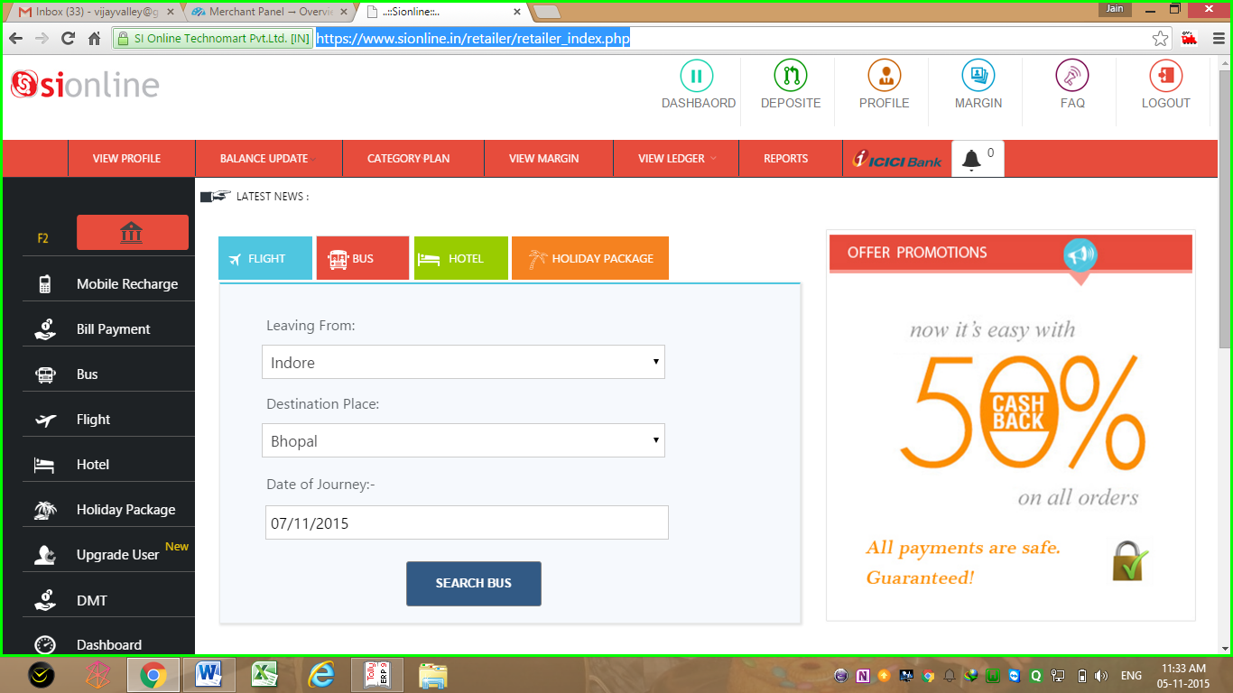
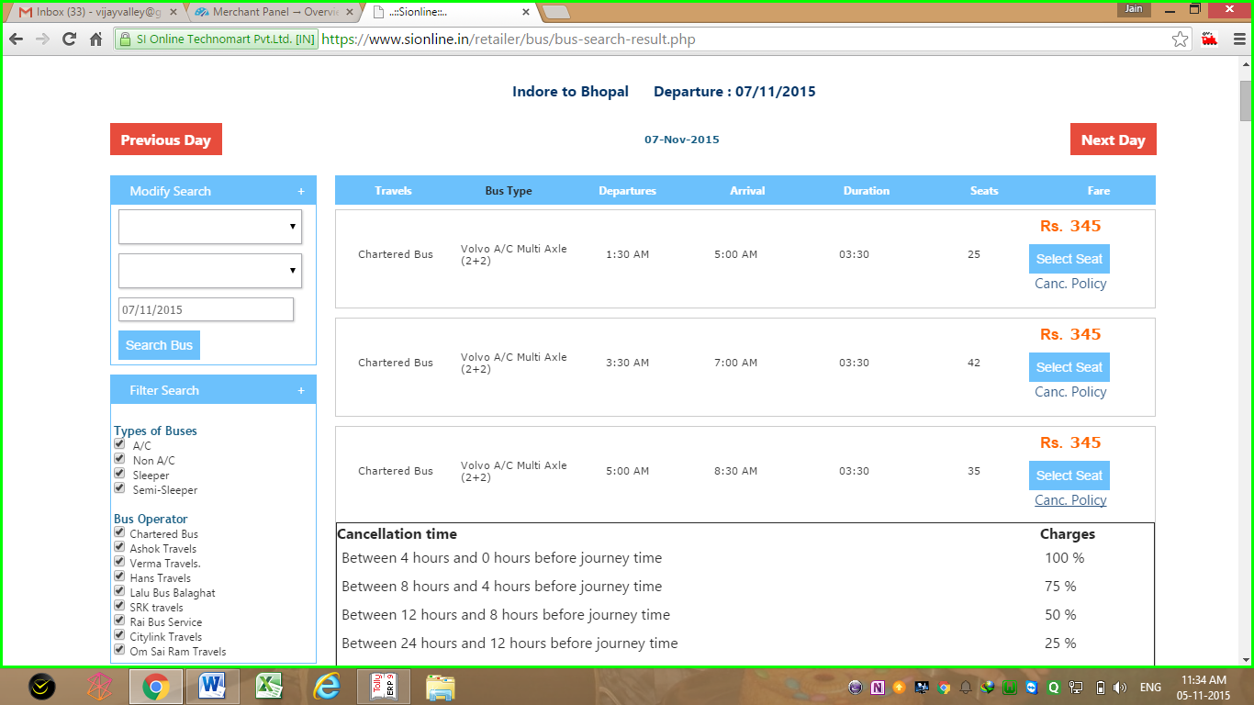
Bus ticket booking page
<<<< Bus Booking Search
Bus Booking Result Page >>>
Search Bus Ticket for All india Aproximate 500+ Routes
Get Results for Arrival/Departure Time,
Booking & Cancellation Policy, Fares. Refine Search, Modify, Print, ETC

Slide 26
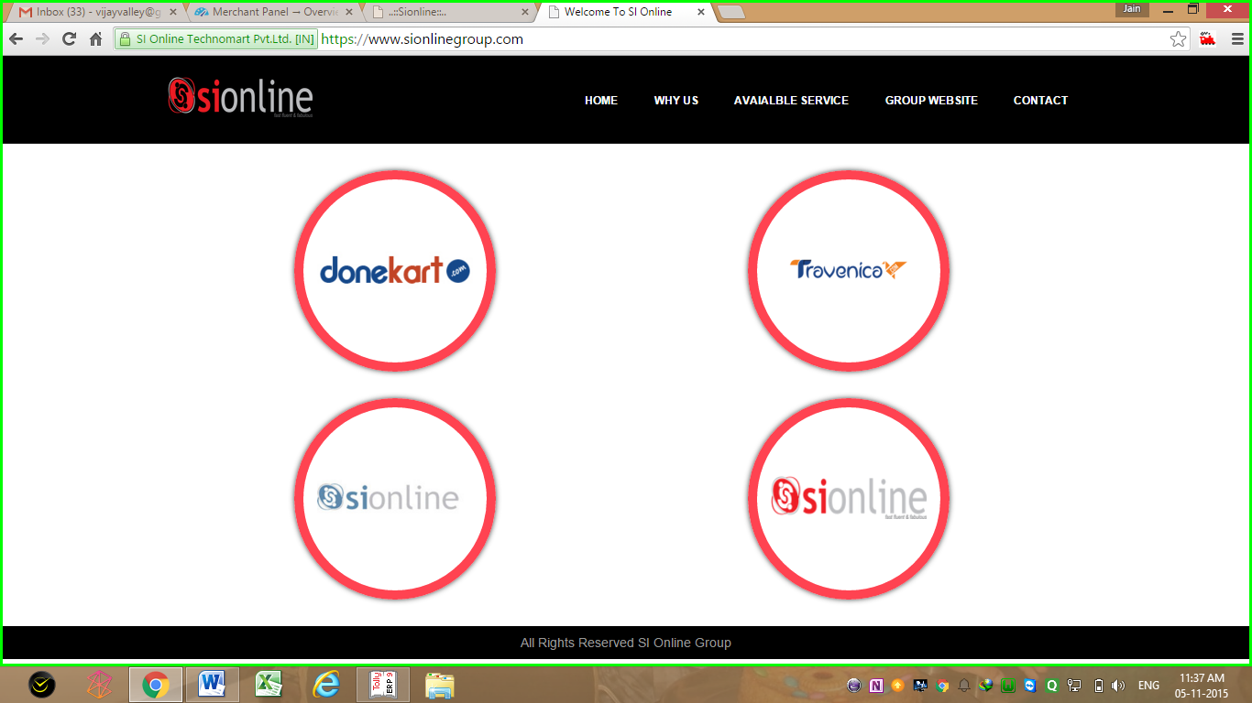
Si Online group

Slide 27
Thank You
Visit us at
www.sionline.co.in
Call Us at
07412-660-330
Email Us at
support@sionline.co.in
Meet Us at
Si Online Technomart Private Limited,
Plot No. 6, Near Rangoli,
Indore- Neemuch Highway.
Ratlam (MP) 457001

