Slide 1
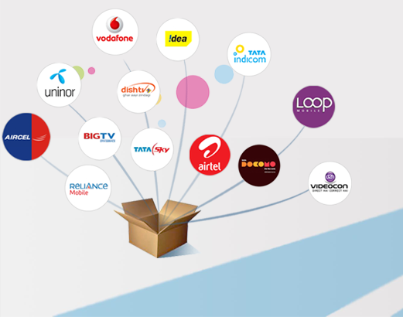
Si Online technomart private limited
Prepaid recharge, bill pay, Air & bus ticket & more

Slide 2
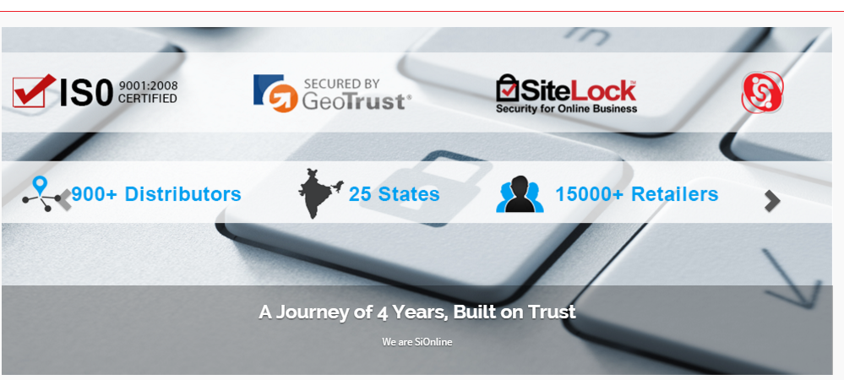
About SiOnline
A Journey of Successful 4 Years, Built on Trust
GeoTrust & Sitelock Secured, ISO 9001:2008 Certifed Company
Pan India Network of 900+ Distributors, 15000+ Retailers

Slide 3
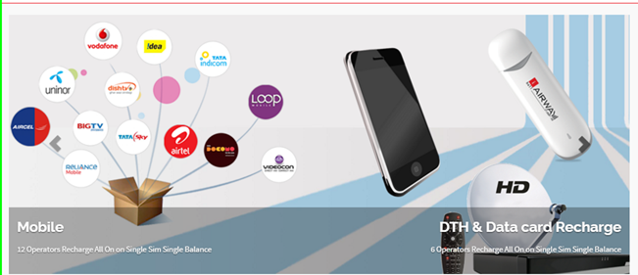
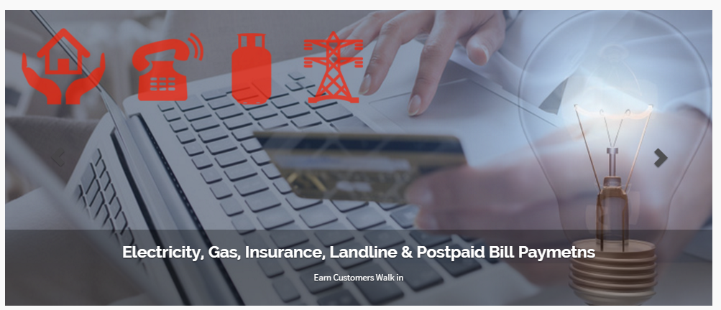
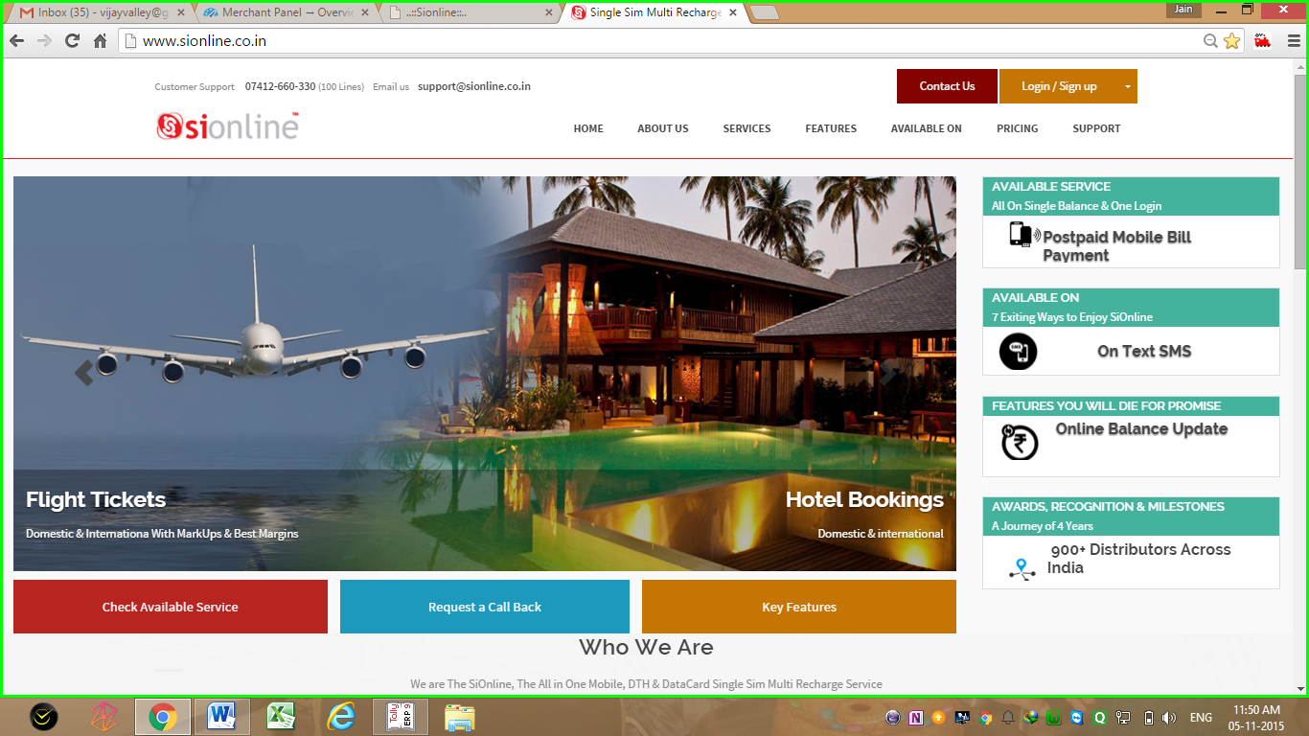
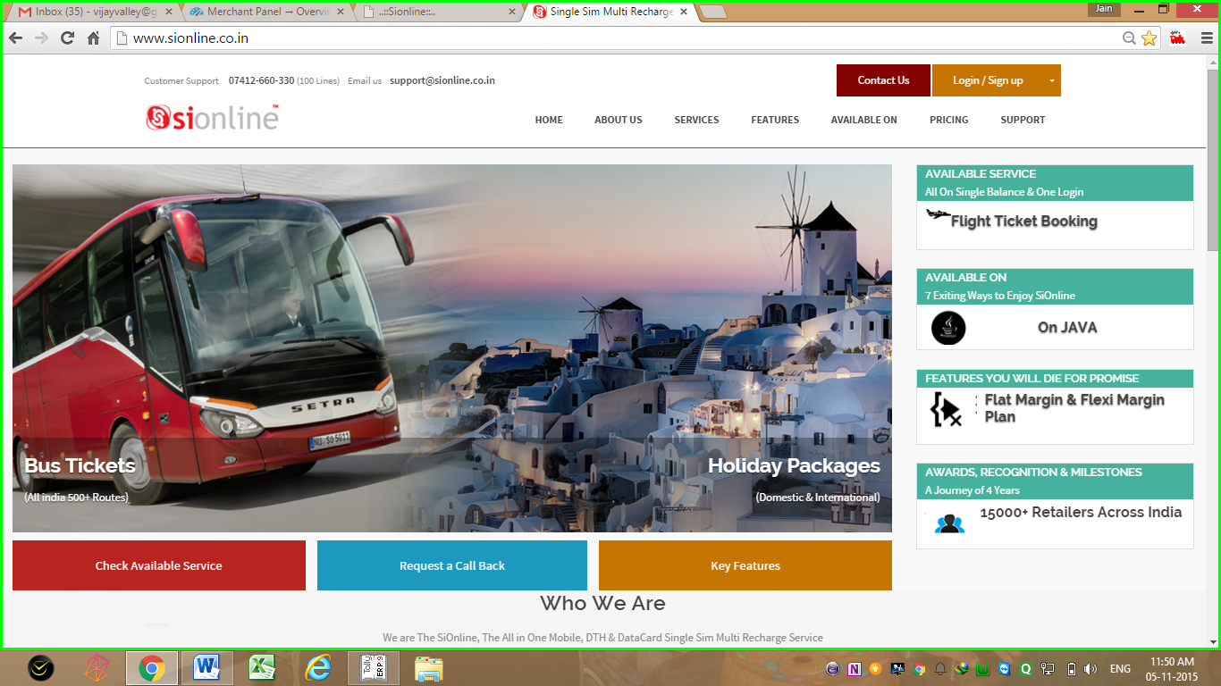
SiOnline recharge , bill pay & Travel Services
Mobile and DTH Recharge, Bill-Pay, Air Ticket, Bus ticket,
Holiday Packages, Hotel Bookings, Money Transfer

Slide 4
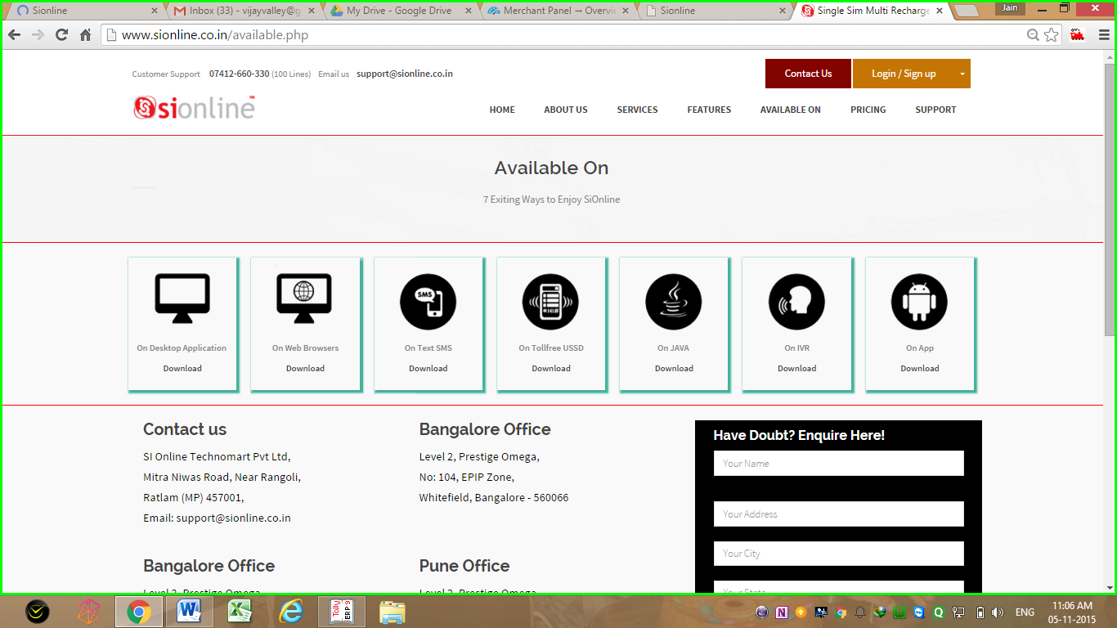
3 Exiting ways to enjoy Si Online
Available on
SMS
Available on Web Application, SMS Recharge & Android App
Available on
Android
Available on
Web
Also Coming Soon on Toll free USSD, IVR & JAVA APP

Slide 5
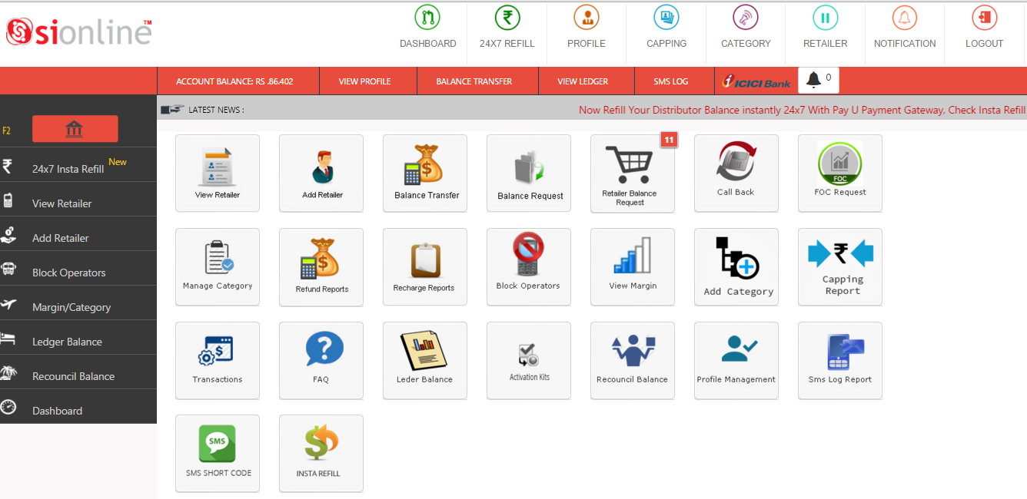
Distributor Login Dash Board
News, Events, Notifications, Quick Links, Wallet Update, Add Retailer, Call Back Request, FAQ, SMS Log, Settings ETC,
All on Single Dash Board Console

Slide 6
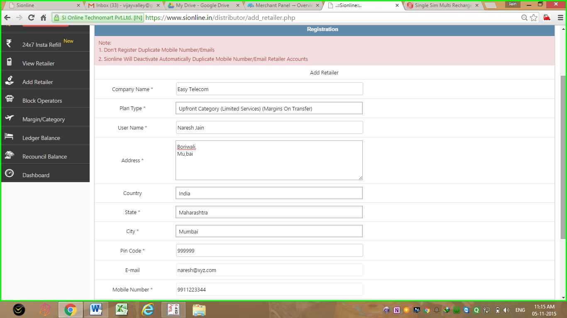
Add new retailer page in distributor Login
Shop Name
General Details
Address
City & State
Pin Code ETC.
Live Account Creation of Retailer
Unique Email ID &
Mobile Number

Slide 7
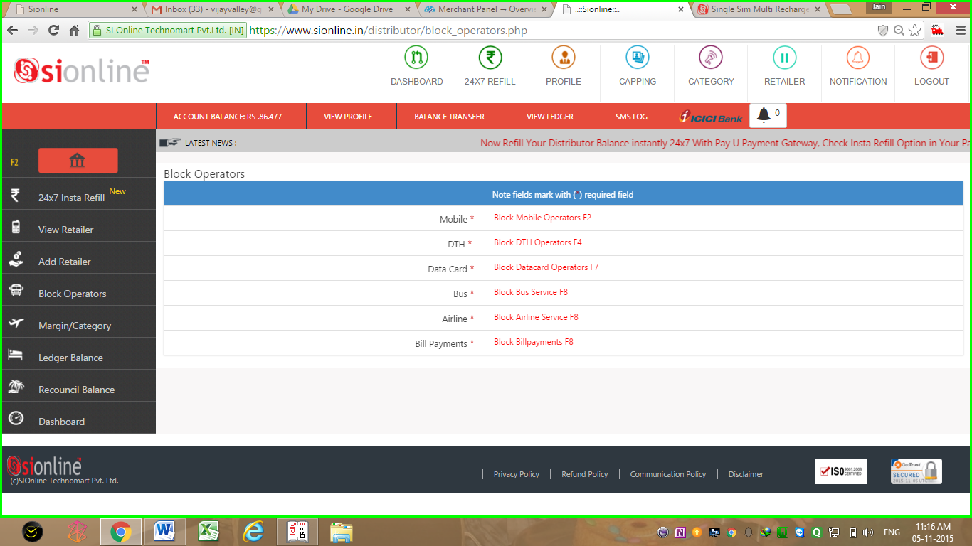
Control panel to Activate/Deactivate operators/services for your downline
Block Here Any One or All
Mobile/DTH/Datacard
Block Here
Air/Bus/Bill Payment
You Can Choose & Block Any or All Operators Recharge for Retailers in Your Panel

Slide 8
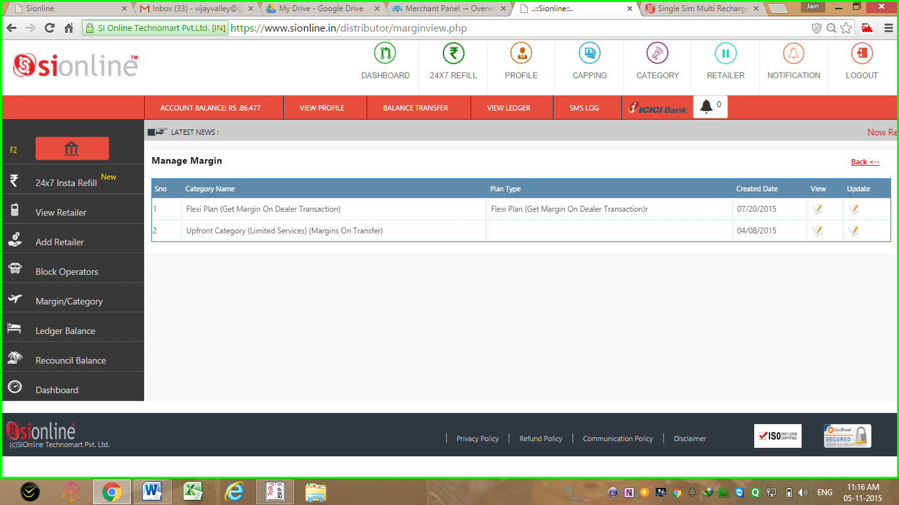
Option to choose flat or flexi margin category Plans for Your Retailers,
Edit Here Margin Plans
View
Margin Plans
Flexi Margin Plan
Upfront Flat Margin Plan
Both Will Be Available in Your Account. You Can Choose Any 1 when u add Retailer

Slide 9
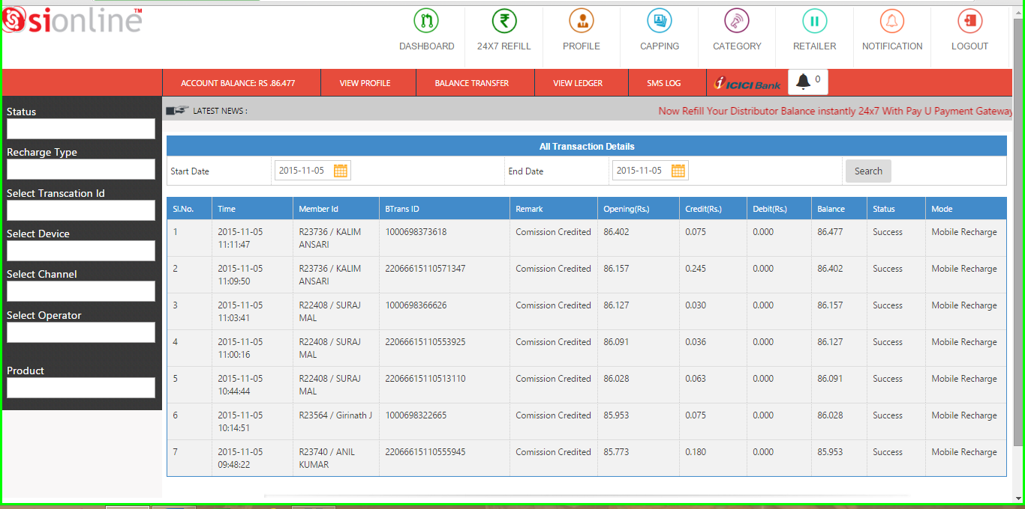
Commision & account ledger report
Opening / Debit / Credit / Commision & Closing Balance Details
Retailer ID & Name
Transaction ID
Date & Time of Transaction
Check Your Daily, Weekly & Monthly Account Statements Here
With Details of Retailer ID, Commision, Opening & Closing Balance

Slide 10
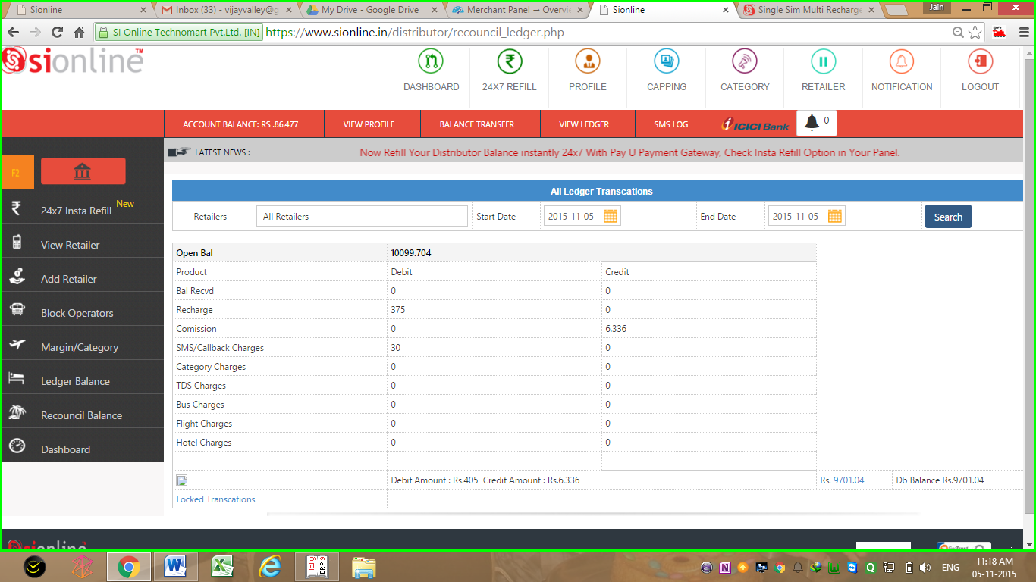
Recouncilation Report
Date Range Selector
Opening Balance
Selected Date Range
Debit & Credit Details
Balance Sent & Rcvd
Recharge
Commision
Charges, ETC
Closing Balance
Check Your Day/Month Wise Recouncialtion Opening & Closing Balance,
Balance Transfers, Commisions & Charges Etc. Here

Slide 11
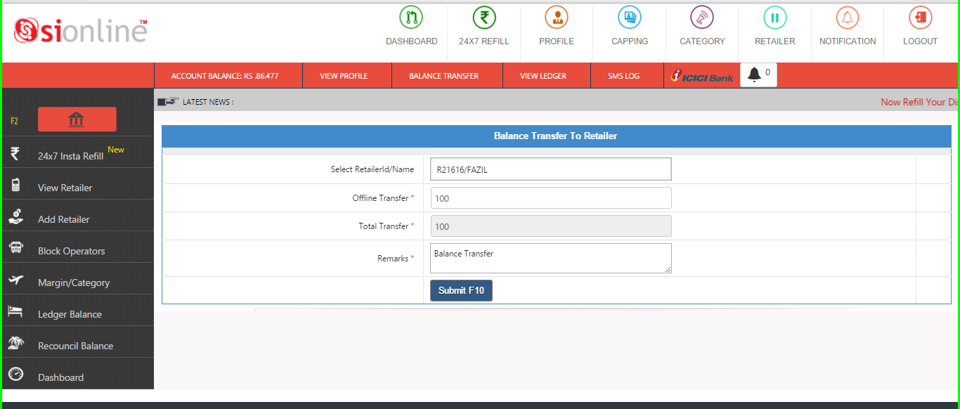
Transfer Balance to retailer page
Transfer Balance By Retailer Number Or ID
Enter Amount
Submit Button
Just Select Retailer Name & update Amount to Transfer Balance

Slide 12
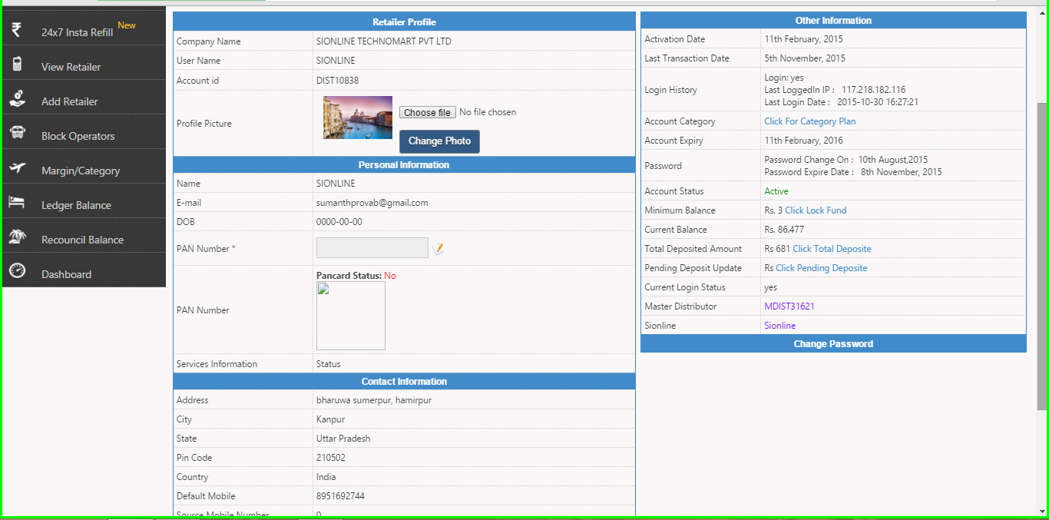
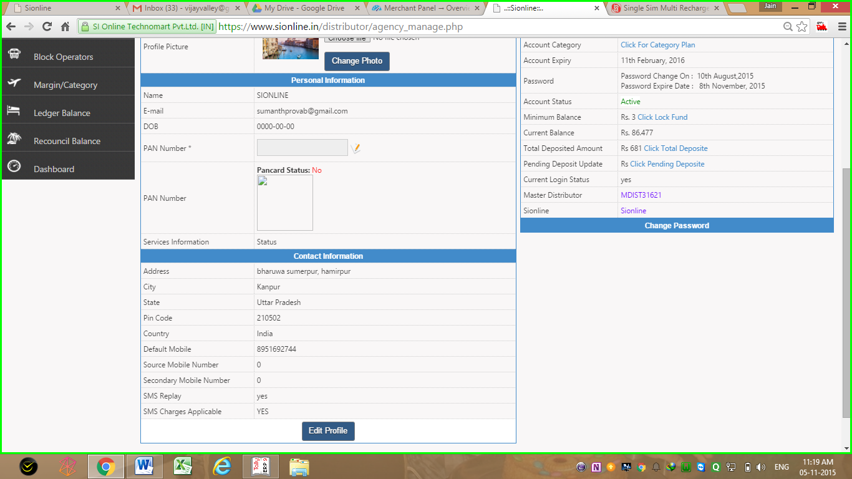
Profile management
View Your Account Details in Profile biz Date of Activation, Balance, Category, Change Mobile Number, Email ID, Update Password ETC,
User Profile
Your Account Activation Details
Personal Info
DOB / PAN Card
Email
A/C Status
Contact information
Default Number
Secondary Number
3rd Number
Add Upto 3 Numbers in Single Profile >>

Slide 13
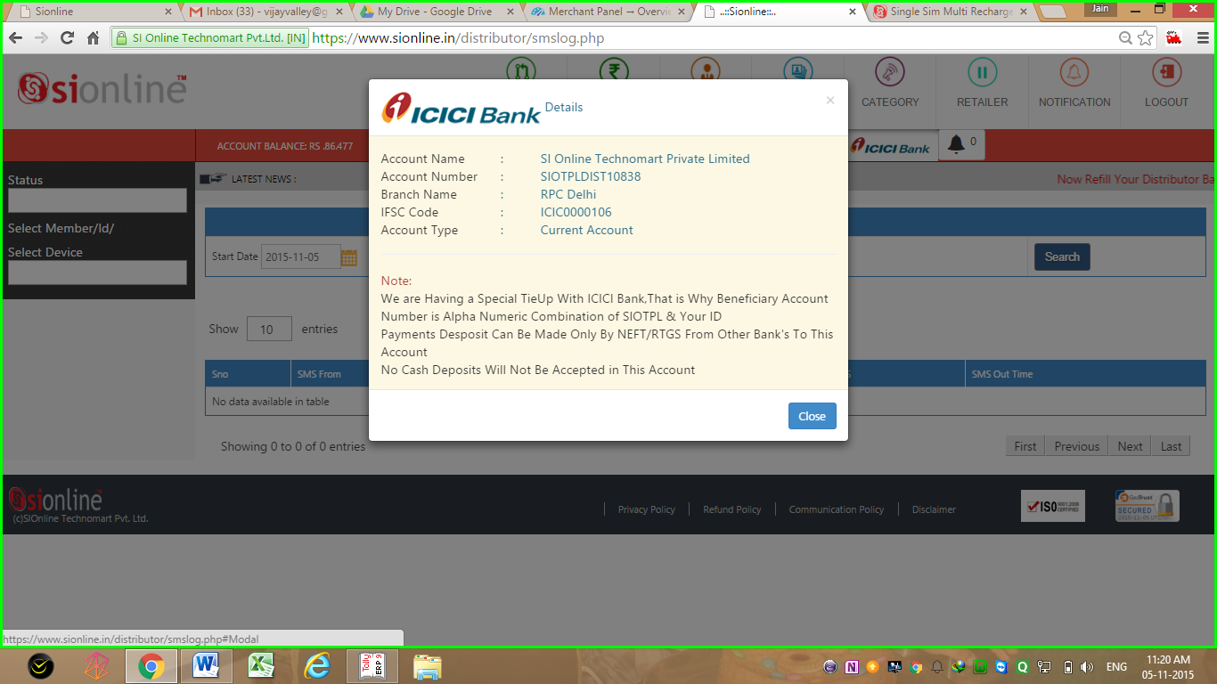
Customised ICICI Bank Corporate Account Creation Tie Up
for Every Retailer & Distributor Added, For Faster NEFT Balance Update
Account Name
Account Number & Other Details
Dedicated Account Number in Combination of SiOTPL &
Your Dealer ID
Click On ICICI Bank Logo
To Know Dedicated
ICICI Bank Account Details

Slide 14
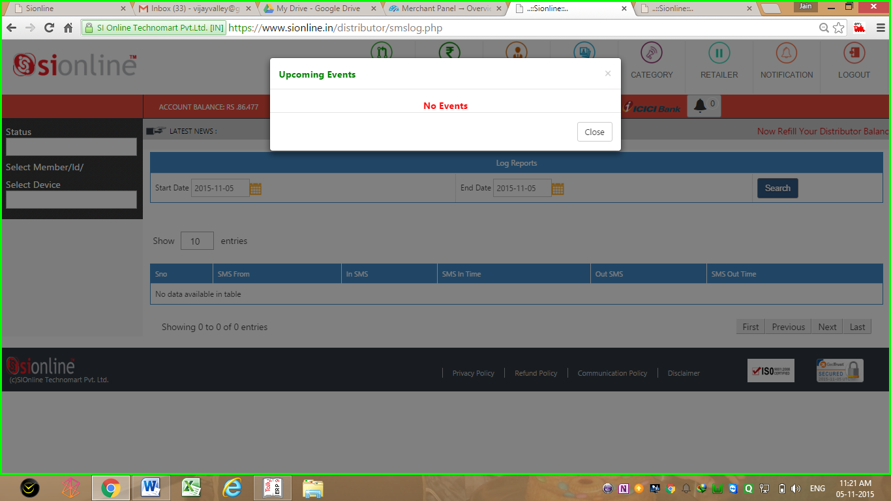
Get Details & Pre information of Upcoming Events in Your Login
Upon Clicking the Notification Bell
Notification & Events PopUp
Upcoming Events & Notification Bell
Events Details fro Bank Holidays – Festivals – New Updates – Additions in Service ETC

Slide 15
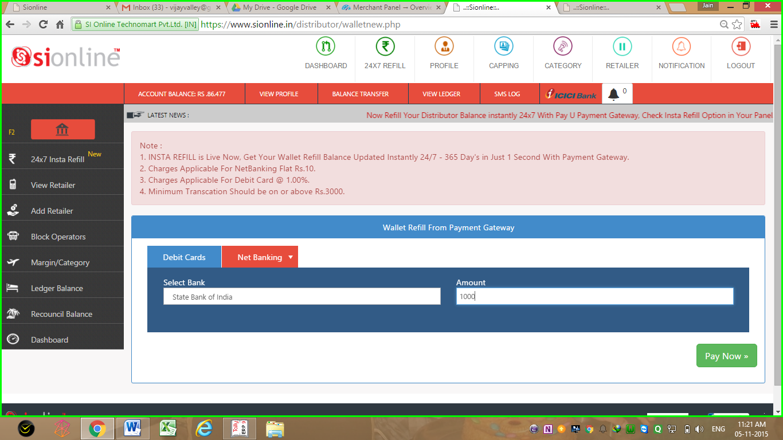

Insta Refill Option for 24x7 365 Days Balance Update
24x7 insta Refill Menu
Live Balance Update in 2 Second’s
Insta Refill 24x7 Available on
Debit Card & Net Banking
Powered By
Getting Low in Balance, Nothing to Worry…
Get Your Account Balance Updated instantly, With Secured PayU Payment Gateway

Slide 16
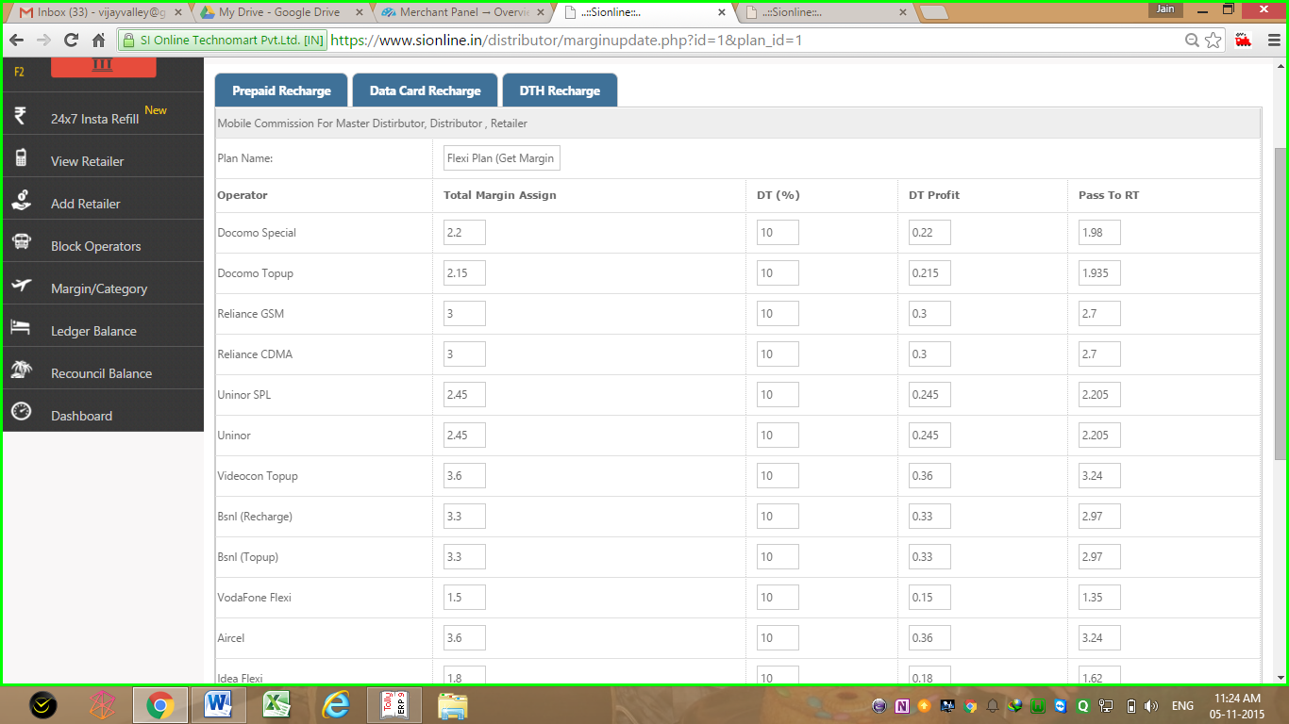
Customize your margins for recharge in flexi plan
Select Here Margin You Want To Keep
Total (-) Distributor Margin
Rest Will Be Credited To Retailer
Total Margin of
Distributor Details
Set Here How Much % Margin You Want to Keep & how You Want to Transfer to Retailer

Slide 17
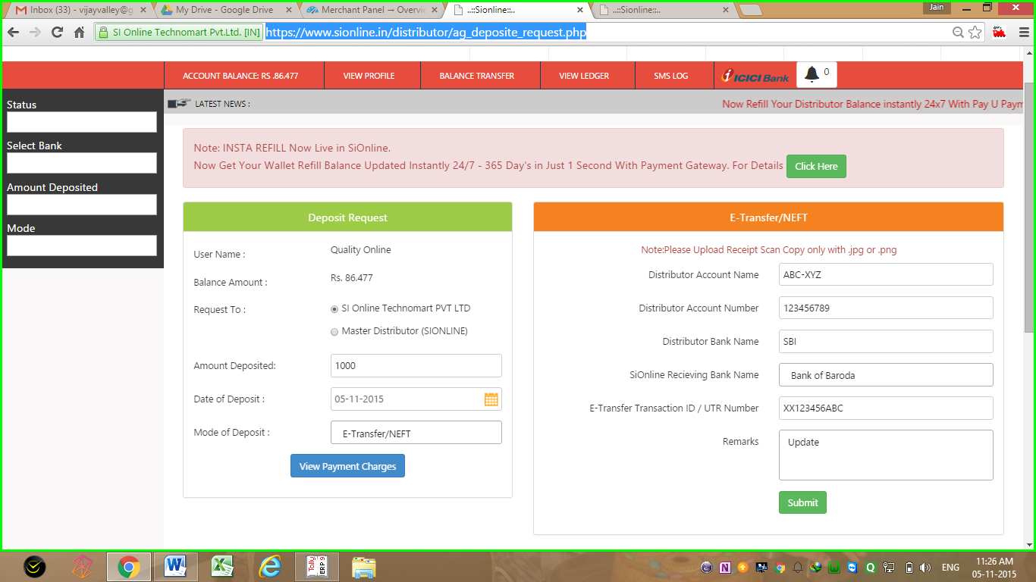
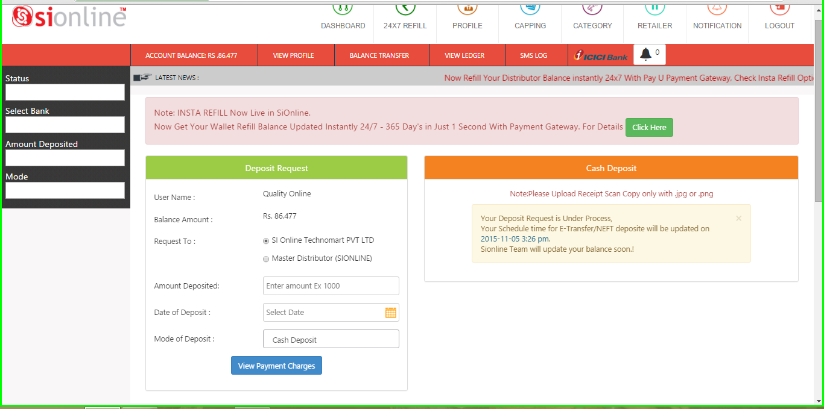
Deposit request page
No Need To Call SiOnline when you deposit payments for balance.
Just update request to get balance automatically in scheduled time.
Depositor Details
& Amount
and Date
Details
Schedule Time Display for Estimated Update Time >
Result Page Showing Estimated Time of Wallet Refill

Slide 18
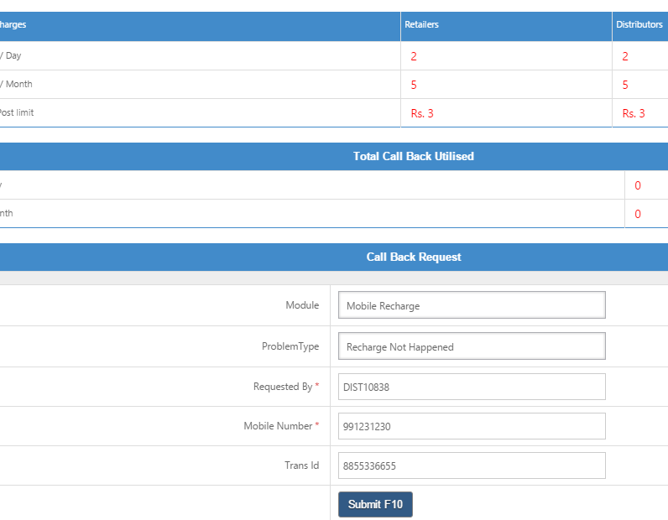
Call back request option
No Need to Waste Your Money in Calling SiOnline.
Simply Update Call Back Request & We Will Call You Back !!!!
Call Back Request Page

Slide 19
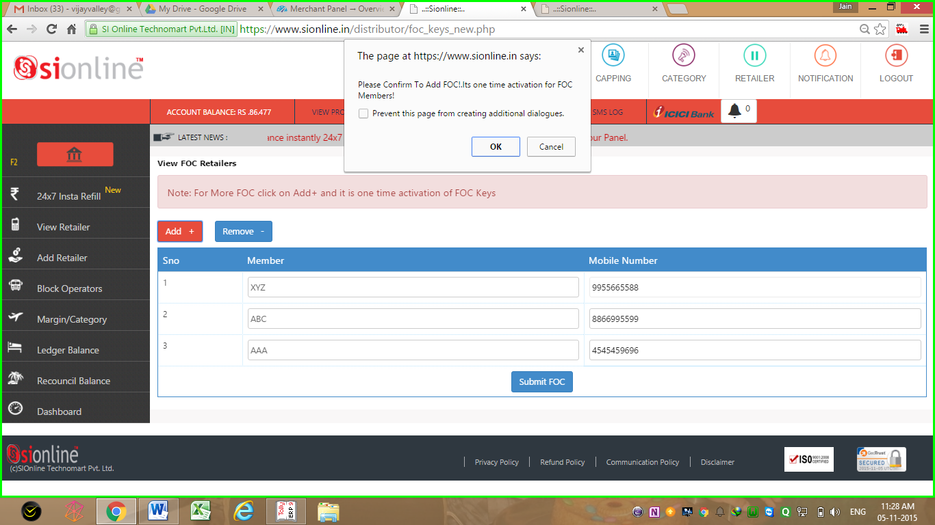
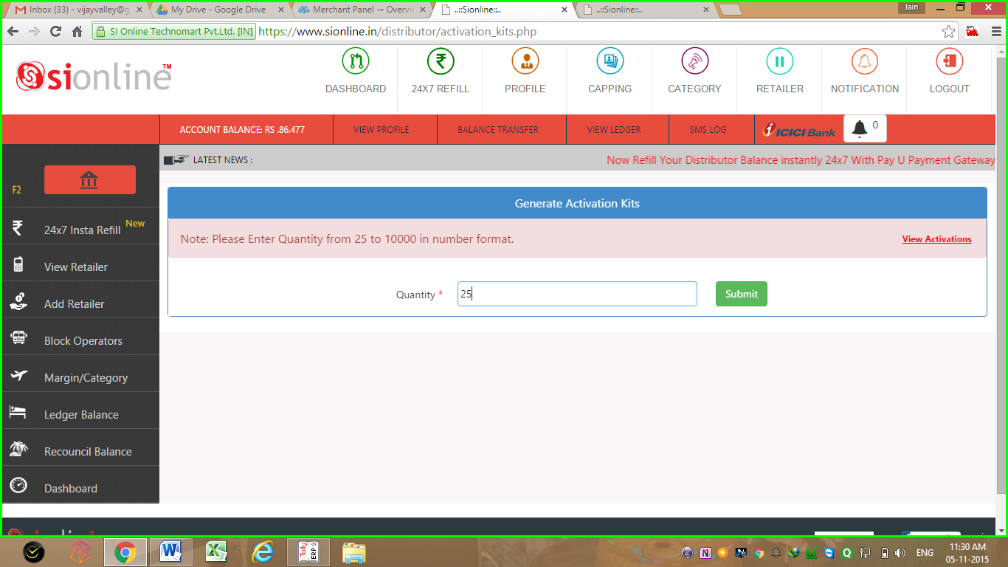
Activation pins request page
<<<<<
Free of Cost Activation Pins Request Page To Get Activation Pins F.O.C.
For Existing Retailers Only (T&C Apply)
Add Here Free of Cost Activation Pin’s
For Your Existing Retailers
You Can Add “N” Numbers Here
But Only 1 Time
Paid Activation Pins Request Page for New Retailers Additions >>>>
Paid Activation Keys for New Retailer’s

Slide 20
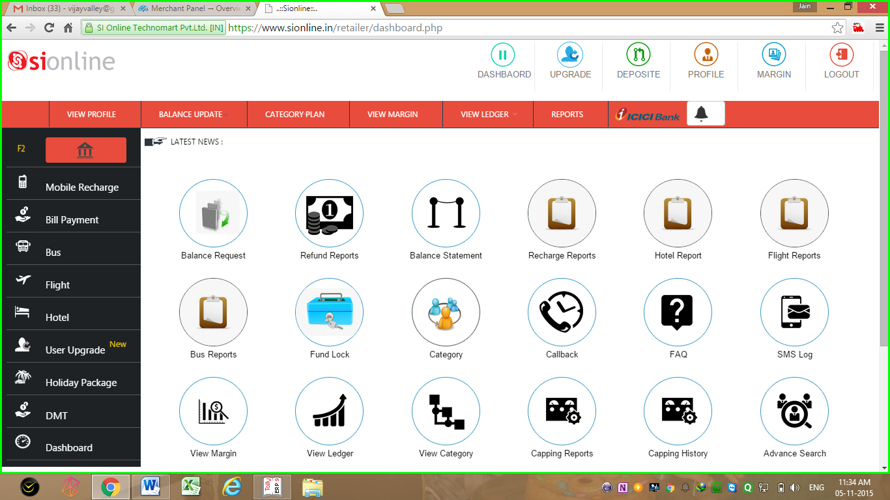
Retailer Login Dash Board

Slide 21
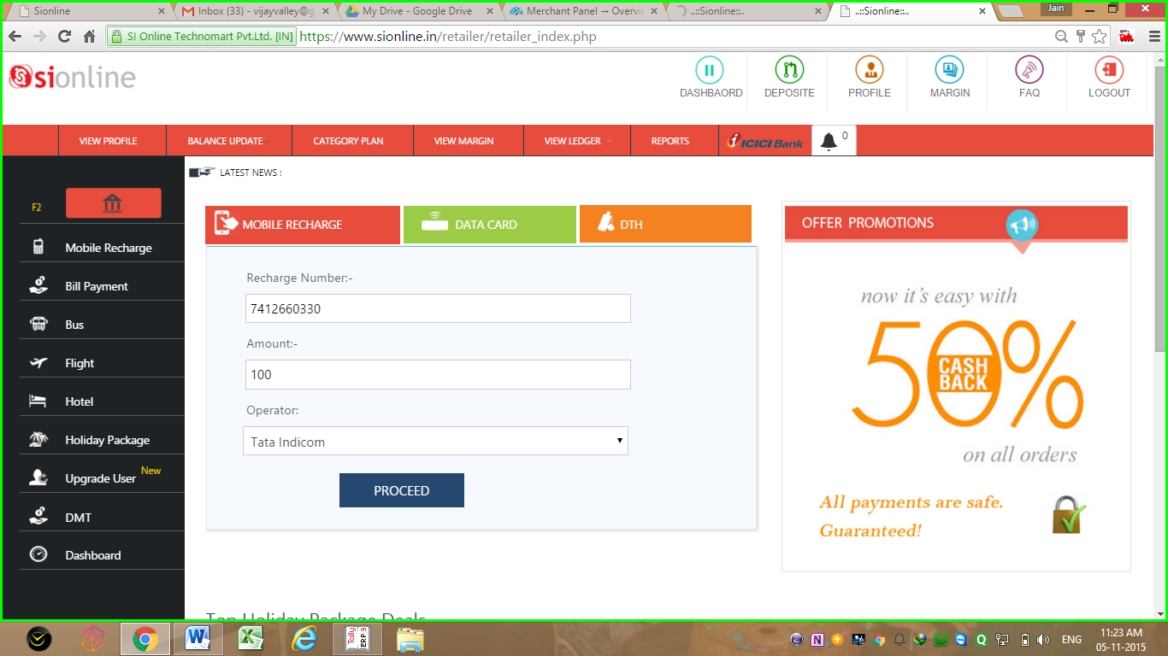
Retailer Mobile & DTH Recharge Page
Customer Number
Recharge Amount
Recharge in
2 To 3 Seconds
Select Operator
Insert >> Proceed >> Confirm >> & its Done in Just Seconds

Slide 22
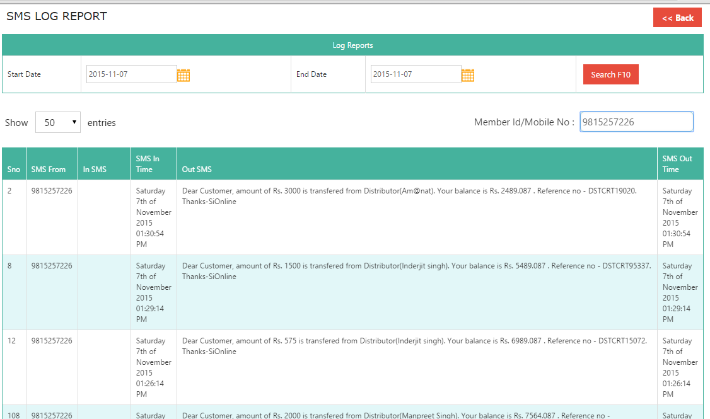
SMS Log Report to Check SMS Sent to Server & Reply Received From SiOnline
Search Box
SMS IN Time
SMS Reply Sent
Sender Number
SMS Reply Time
Compare Here SMS in Time & SMS Reply Time
It’s Just 2-3 Seconds
Retailer/Distributor Can Check the SMS they have sent to Server & SMS Reply Received from Server including System Generated SMS with SMS in & SMS Out Time

Slide 23
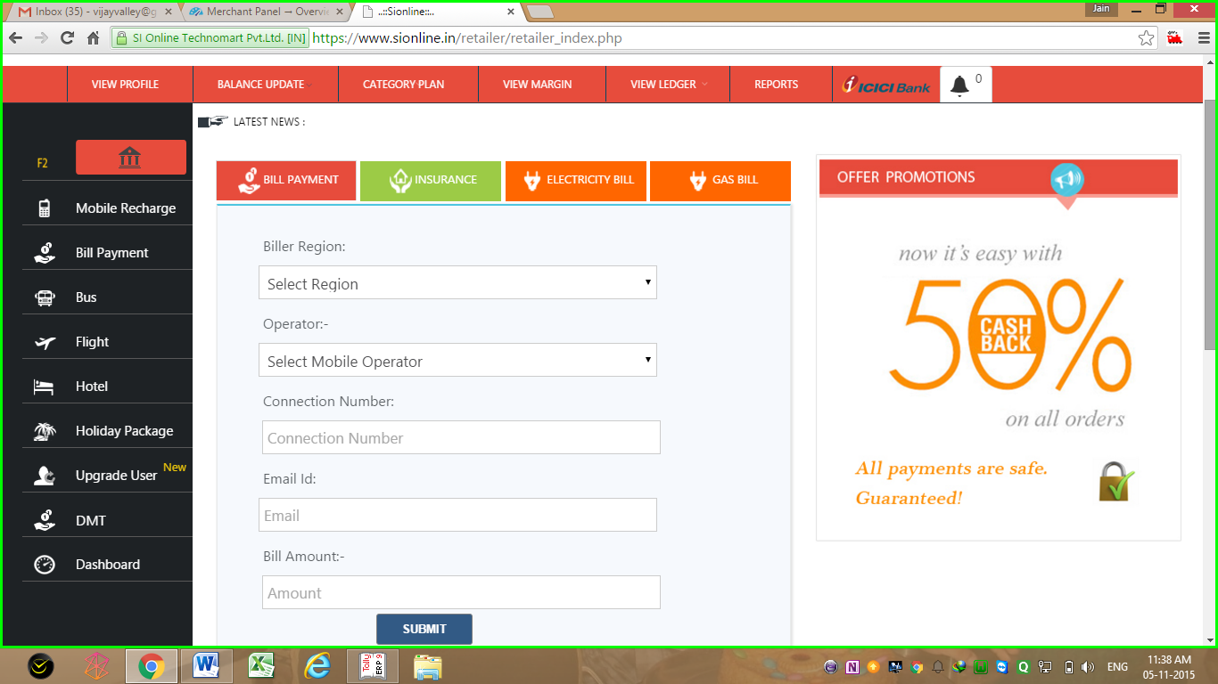
Retailer Bill Payment, Gas Bill, Electricity Bill Payment Page
Pay Your Bills Here With SiOnline & Get Customer’s Satisfaction

Slide 24
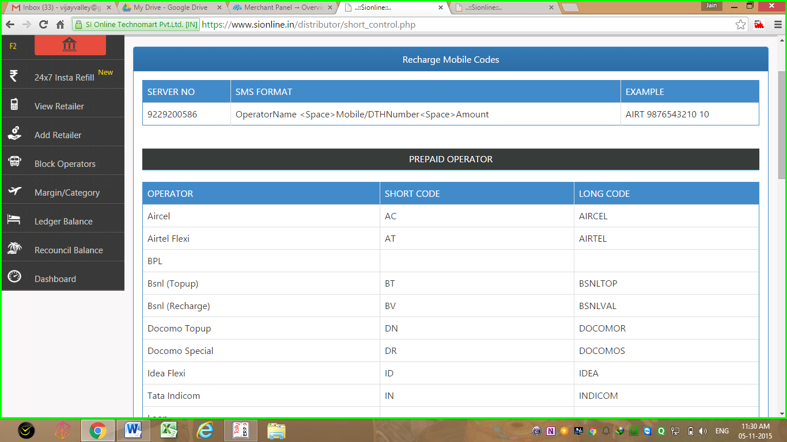
SMS Recharge syntax
Recharge SMS Codes Short Code & Long Codes
All in Your
Distributor & Retailer Login
Get details of operators Recharge Codes
in Your Retailer & Distributor Login Panel
Short Codes
Long Codes
Mobile/DTH/DataCard
Operator Name

Slide 25
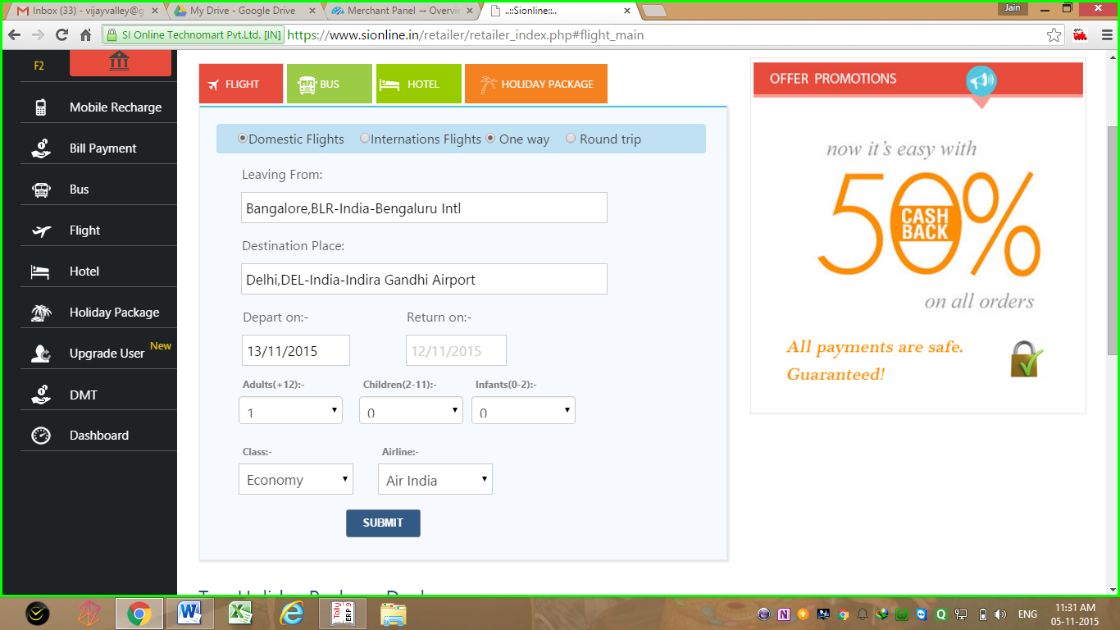
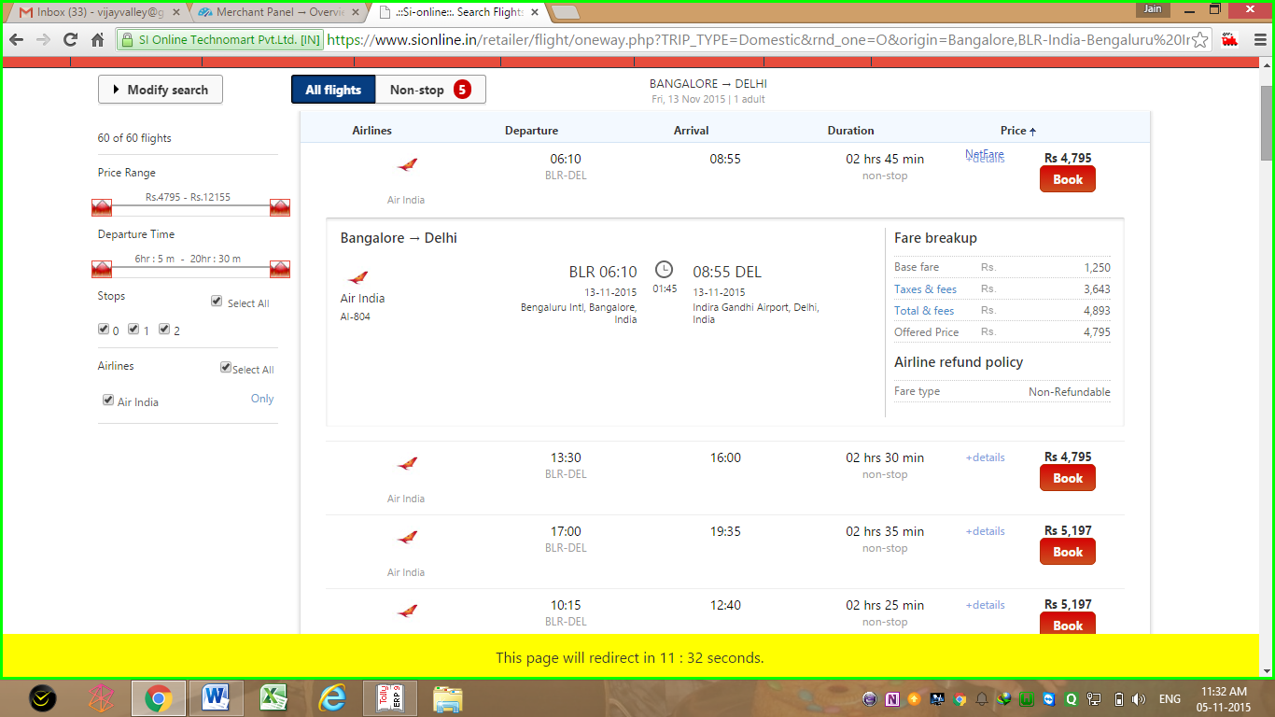
Air ticket booking page
<<< Search Air Ticket Page
Air Ticket Result Page >>>>>>
Search Domestic & international Air Ticket
Get Results for Arrival/Departure Time,
Booking & Cancellation Policy, Fares. Refine Search for Airlines, Modify , ETC

Slide 26
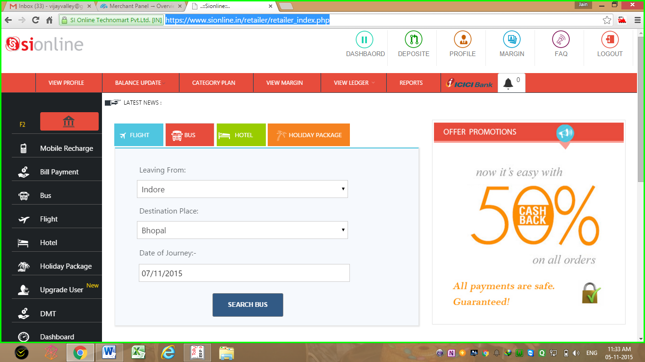
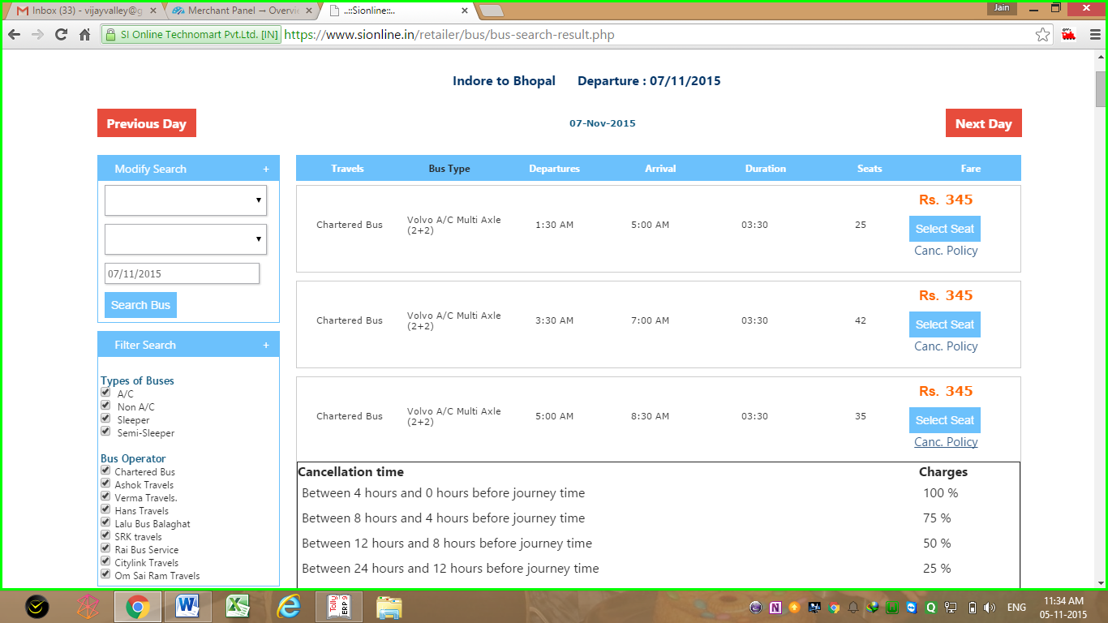
Bus ticket booking page
<<<< Bus Booking Search
Bus Booking Result Page >>>
Search Bus Ticket for All india Aproximate 500+ Routes
Get Results for Arrival/Departure Time,
Booking & Cancellation Policy, Fares. Refine Search, Modify, Print, ETC

Slide 27
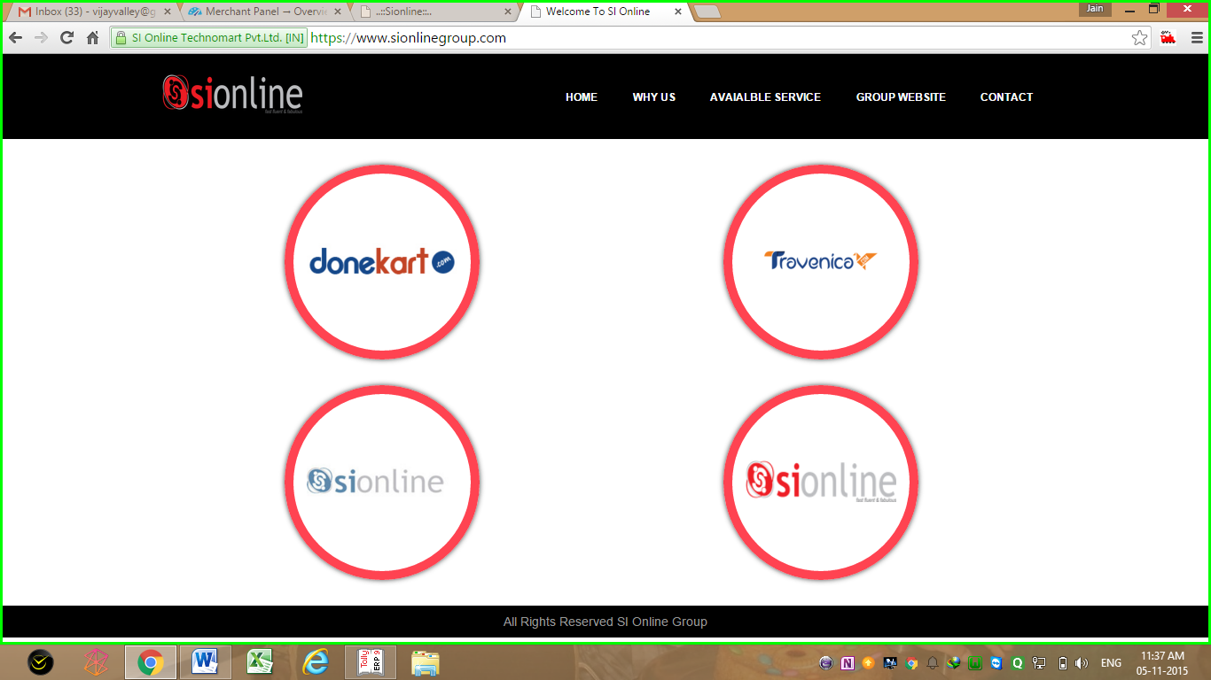
Si Online group

Slide 28
Thank You
Visit us at
www.sionline.co.in
Call Us at
07412-660-330
Email Us at
support@sionline.co.in
Meet Us at
Si Online Technomart Private Limited,
Plot No. 6, Near Rangoli,
Indore- Neemuch Highway.
Ratlam (MP) 457001

