Slide 1

Testing…………………
Prepaid recharge, bill pay, ticketing & more

Slide 2
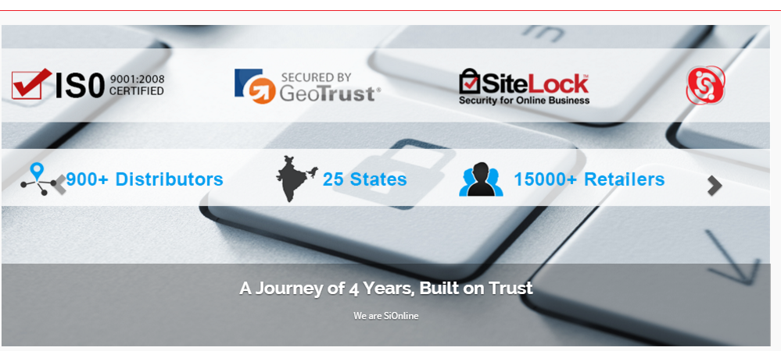
About SiOnline
A Journey of Successful 4 Years, Built on Trust
GeoTrust & Sitelock Secured, ISO 9001:2008 Certifed Company
Pan India Network of 900+ Distributors, 15000+ Retailers

