Slide 1
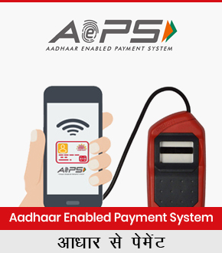
Si Online Technomart private limited
AEPS – Aadhar Enabled Payment System

Slide 2
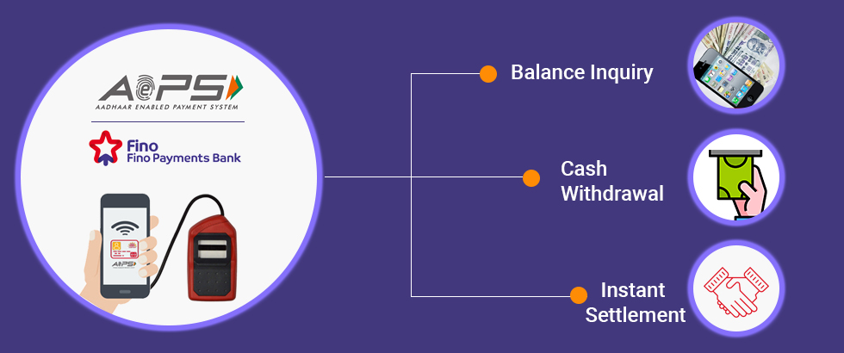

Slide 3
Introduction:
We introduce Our Self as SI Online Technomart Private Limited, A Company Founded in Year 2011 With Working for Mobile & DTH Multi Recharge. From There to Today we have came a long Way as Authorised Principal Service Provider of IRCTC in May'2018

Slide 4
Our Presence & Network:
Having Presence in Across India in All States From East to West & North To South., we right now have around 1000+ LIVE WORKING AGENTS in all verticals Biz Telecom, Travel, Medical Stores, Ticket Booking Centres, E-Governace Facilation Centres & Across Geographies of INDIA in All States of India from Kashmir to Kanyakumari

Slide 5
Actual Photograph of Some of Our Agents Across India

Slide 6
Services We Offer:
IRCTC Agent Registration for Railway E-Ticket Booking
AEPS – Aadhar Enabled Payment System
BBPS – Bharat Bill Payment System
Mini ATM Cash Withdrawl
Micro ATM Card Swipe Machine
AIR & Bus Ticket Booking
Mobile & DTH Recharge

Slide 7
About AEPS – What is AEPS ?
AePS is a bank led model which allows online interoperable financial inclusion transaction at PoS (MicroATM) through the Business correspondent of any bank using the Aadhaar authentication.AePS allows you to do Various types of transactions.
The only inputs required for a customer to do a transaction are:-
IIN (Identifying the Bank to which the customer is associated)
Aadhaar Number
Fingerprint captured during their enrollment

Slide 8
SiOnline AEPS Agent Registration
SI Online Technomart is Authorised By FINO BANK for AEPS Agent Registration, With Trust of Over 9 Years SiOnline is India's Leading Provider for AEPS Agent Registration, SiOnline is allowed to appoint Authorised AEPS (Aadhar Enabled Payment System) agent across india. we provide AEPS AGENT REGISTRATION Facility through our Aadhar Enabled Payment System Agent registration done through sionline. contact us for aadhar enabled payment system - AEPS Agent Registration. aeps agent kaise bane. AEPS is an Aadhar Card Verification Based System for Cash Withdrawl & Balance Inquiry of Any Bank Account in India. With AEPS You Can do Cash Withdrawl & Balance Inquiry 24x7x365. With SiOnline AEPS you get instant transaction confirmation, SiOnline AEPS - Powered Directly By FINO Bank.

Slide 9
AEPS Features – Aadhar Enabled Payment System
AEPS Based Payment Solution
AEPS Services offered By NPCI
Access any bank account through aadhar Verification
Any Bank Cash Withdrawl
Any Bank Account Balance inquiry
Service Available 24 x 7 - 365 Days
Easy to Use, Safe & Secure Method
Very Simple Aadhar Finger Authentication
Convert Shop into a Mini Bank
Work from Home, Shop or Office

Slide 10
Documents Required for AEPS Agent Registration
Registration Details / रजिस्ट्रेशन विवरण
Proof of Address / पते का प्रमाणीकरण
Pancard Copy / पैनकार्ड कॉपी
Photograph / फोटोग्राफ
Mobile Number / मोबाइल नंबर
Eamil Id / ईमेल आईडी

Slide 11
SiOnline’s AEPS Service - Key Features
SiOnline AEPS - Powered Directly By FINO Bank
No Third Party Transaction Routing
Instant Transaction Confirmation
T+1 Transaction Settlement
Unlimited Customers AEPS Transaction

Slide 12
Requirements For AEPS Agent Registration
Finger Print Scan Biometric Device
Computer or Mobile Phone
Internet Connection
Printer

Slide 13
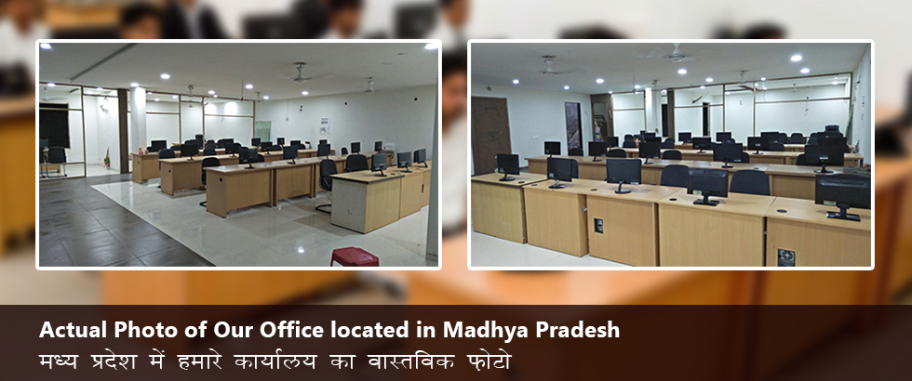
Fully Equipped Office Of Over 2000+ Square feet

Slide 15
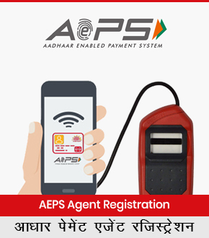

Slide 16
Our Team:
Inhouse Team for Development & Designer
Self Owned Dedicated Servers
Inhouse Sales & Support Team of 43+ Persons

Slide 17
Our Stength & Capability:
In a mere Small period of 1 Year Months after becoming Authorised Principal Service Provider of IRCTC, we have appointed around 700+ IRCTC Agents Across india.

Slide 18
Services We Offer:
IRCTC Agent Registration for Railway E-Ticket Booking
AEPS – Aadhar Enabled Payment System
BBPS – Bharat Bill Payment System
Mini ATM Cash Withdrawl
Micro ATM Card Swipe Machine
AIR & Bus Ticket Booking
Mobile & DTH Recharge

Slide 19
Thank You
Visit us at
www.sionline.co.in
Call us at
8821822500
Email Us at
support@sionline.co.in
Meet Us at
Si Online Technomart Private Limited,
6, Mitra Niwas Road,
Near Rangoli,
Ratlam (MP) 457001

Slide 20
Page Keywords:
AEPS AGENT REGISTRATION
AEPS AGENT REGISTRATION | AEPS Agent Registration | aeps agent registration | aeps agent login | aadhar enabled payment system agent registration | become aeps agent | create aeps agent login id | aeps agency registration | aeps agent kaise bane | aeps license | aeps agency provider | aeps authorised agent institution | aeps authorized agent | aeps principal service provider | aeps agent registration fee | aeps agency provider | how to get aeps agency | irctc agent registration | kisok banking | bank grahak seva kendra | fastag | aeps | aadhar enabled payment system | bharat bill payment system | mini atm | money trasnfer | bbps | irctc | Pancard | uti psa pancard agent registration | multi recharge sim

