Slide 1
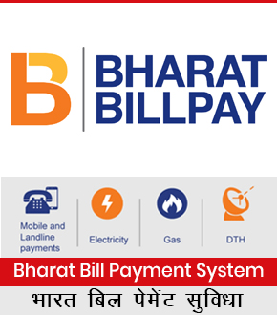
Si Online Technomart private limited
BBPS – Bharat Bill Payment System

Slide 2
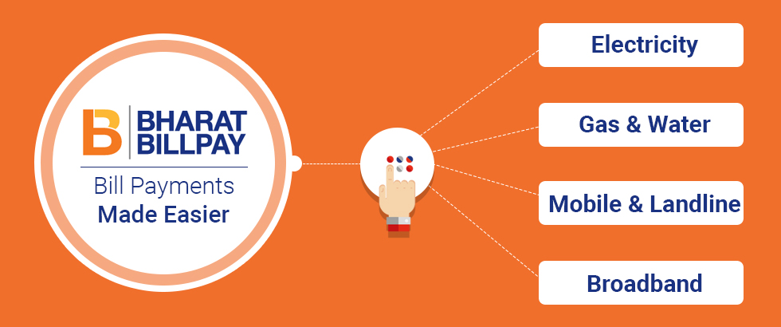

Slide 3
Introduction:
We introduce Our Self as SI Online Technomart Private Limited, A Company Founded in Year 2011 With Working for Mobile & DTH Multi Recharge. From There to Today we have came a long Way as Authorised Principal Service Provider of IRCTC in May'2018

Slide 4
Our Presence & Network:
Having Presence in Across India in All States From East to West & North To South., we right now have around 1000+ LIVE WORKING AGENTS in all verticals Biz Telecom, Travel, Medical Stores, Ticket Booking Centres, E-Governace Facilation Centres & Across Geographies of INDIA in All States of India from Kashmir to Kanyakumari

Slide 5
Actual Photograph of Some of Our Agents Across India

Slide 6
Services We Offer:
IRCTC Agent Registration for Railway E-Ticket Booking
AEPS – Aadhar Enabled Payment System
BBPS – Bharat Bill Payment System
Mini ATM Cash Withdrawl
Micro ATM Card Swipe Machine
AIR & Bus Ticket Booking
Mobile & DTH Recharge

Slide 7
About BBPS – What is BBPS?
Bharat Bill Payment System (BBPS) is an integrated bill payment system in India offering interoperable and accessible bill payment service to customers through a network of agents of registered member as Agent Institutions (AI), enabling multiple payment modes, and providing instant confirmation of payment.
National Payments Corporation of India (NPCI) functions as the authorised Bharat Bill Payment Central Unit (BBPCU), which will be responsible for setting business standards, rules and procedures for technical and business requirements for all the participants. NPCI, as the BBPCU, will also undertake clearing and settlement activities related to transactions routed through BBPS. Existing bill aggregators and banks are envisaged to work as Operating Units to provide an interoperable bill payment system irrespective of which unit has on-boarded a particular biller. Payments may be made through the BBPS using cash, transfer cheques, and electronic modes.

Slide 8
SiOnline AEPS Agent Registration
"SI Online Technomart is TJSB Sahakari Bank Authorised Agent Institution for BBPS Agent Registration, With Trust of Over 9 Years SiOnline is India's Leading Provider for BBPS Agent Registration, SiOnline is allowed to appoint Authorised BBPS Bharat Bill Payment System agent across india. BBPS Facility is Provided By NPCI functioning as BBPCU - (Bharat Bill Payment Central Unit). we provide BBPS agent registration Facility through our bharat bill payment system Agent registration done through sionline. contact us for bharat bill payment system - BBPS agent registration. bbps agent kaise bane. With BBPS You Can collect essential bill payments such as electricity, gas, water, landline, broadband, postpaid etc. sionline also provides other various services like irctc agent registration, uti pancard psa agent registration, kiosk banking, bank grahak seva kendra, multi recharge sim, fastag toll collection, aeps, Aadhar enabled payment system, aeps, bbps, bharat bill payment system, air ticket agent, bus ticket agent, Mini ATM agent registration, Micro ATM Card Swipe Machine, domestic money transfer & many more.

Slide 9
BBPS Features – Bharat Bill Payment System
Bill Payment Service - Any Time, Any Where
BBPS Services offered By NPCI as BBPCU
Service Available 24 x 7 - 365 Days
Both Online & Offline Billers Available
One Point for all essential Bill Payment Solutions
Instant Payment Confirmation
Get Receipt of Payment Instantly
Easy to Use, Safe & Secure Method
Dispute Resolution Mechanism to handle Disputes
Convert Shop into a Mini Bank
Work from Home, Shop or Office

Slide 10
Documents Required for BBPS Agent Registration
Registration Details / रजिस्ट्रेशन विवरण
Proof of Address / पते का प्रमाणीकरण
Pancard Copy / पैनकार्ड कॉपी
Photograph / फोटोग्राफ
Mobile Number / मोबाइल नंबर
Eamil Id / ईमेल आईडी
Latitude & Longitude Details of Centre

Slide 11
SiOnline’s BBPS Service - Key Features
SiOnline BBPS - Powered By TJSB Sahakari Bank
No Third Party Transaction Routing
Instant Transaction Confirmation
Unlimited Bill Payments Daily Without Limit

Slide 12
Requirements For BBPS Agent Registration
Computer or Mobile Phone
Internet Connection
Printer

Slide 13
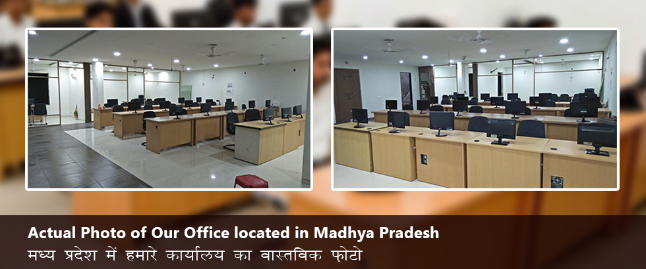
Fully Equipped Office Of Over 2000+ Square feet

Slide 16
Our Team:
Inhouse Team for Development & Designer
Self Owned Dedicated Servers
Inhouse Sales & Support Team of 43+ Persons

Slide 17
Our Stength & Capability:
In a mere Small period of 1 Year Months after becoming Authorised Principal Service Provider of IRCTC, we have appointed around 700+ IRCTC Agents Across india.

Slide 18
Services We Offer:
IRCTC Agent Registration for Railway E-Ticket Booking
AEPS – Aadhar Enabled Payment System
BBPS – Bharat Bill Payment System
Mini ATM Cash Withdrawl
Micro ATM Card Swipe Machine
AIR & Bus Ticket Booking
Mobile & DTH Recharge

Slide 19
Thank You
Visit us at
www.sionline.co.in
Call us at
8821822500
Email Us at
support@sionline.co.in
Meet Us at
Si Online Technomart Private Limited,
6, Mitra Niwas Road,
Near Rangoli,
Ratlam (MP) 457001

Slide 20
Page Keywords:
BBPS AGENT REGISTRATION
BBPS AGENT REGISTRATION | BBPS Agent Registration | bbps agent registration | bbps agent login | bharat bill payment system agent registration | become bbps agent | create bbps agent login id | bbps agency registration | bbps agent kaise bane | bbps license | bbps agency provider | bbps authorised agent institution | bbps authorized agent | bbps principal service provider | bbps agent registration fee | bbps agency provider | how to get bbps agency | irctc agent registration | kisok banking | bank grahak seva kendra | fastag | aeps | aadhar enabled payment system | bharat bill payment system | mini atm | money trasnfer | bbps | irctc | Pancard | uti psa pancard agent registration | multi recharge sim

