Slide 1
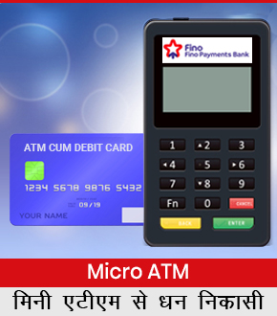
Si Online Technomart private limited
Mini ATM Card Swipe Machine

Slide 2
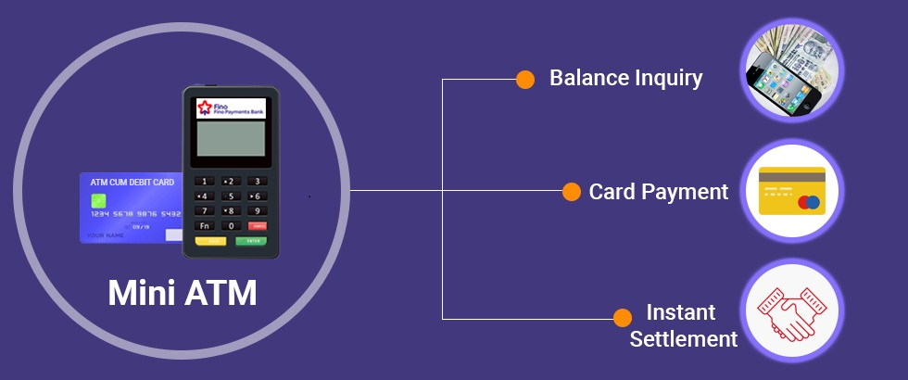

Slide 3
Introduction:
We introduce Our Self as SI Online Technomart Private Limited, A Company Founded in Year 2011 With Working for Mobile & DTH Multi Recharge. From There to Today we have came a long Way as Authorised Principal Service Provider of IRCTC in May'2018

Slide 4
Our Presence & Network:
Having Presence in Across India in All States From East to West & North To South., we right now have around 1000+ LIVE WORKING AGENTS in all verticals Biz Telecom, Travel, Medical Stores, Ticket Booking Centres, E-Governace Facilation Centres & Across Geographies of INDIA in All States of India from Kashmir to Kanyakumari

Slide 5
Actual Photograph of Some of Our Agents Across India

Slide 6
Services We Offer:
IRCTC Agent Registration for Railway E-Ticket Booking
AEPS – Aadhar Enabled Payment System
BBPS – Bharat Bill Payment System
Mini ATM Cash Withdrawl
Micro ATM Card Swipe Machine
AIR & Bus Ticket Booking
Mobile & DTH Recharge

Slide 7
About Mini ATM Card Swipe Machine
Micro ATMs are card swipe machines through which banks can remotely connect to their core banking system. This machine comes with a fingerprint scanner / Card Swipe Option attached to it. In other words, micro ATMs are handheld point of sale terminals used to disburse cash in remote locations where bank branches cannot reach. Micro ATMs are similar to point of sale (PoS) terminals and are a doorstep mobile banking arrangement cum-mobile ATM device.
Mini ATM (Micro ATM) is a Handy Version of ATM for Cash Withdrawl, Accepting Card Based Payment & Balance Inquiry of Any Bank Account in India. With Mini ATM Card Swipe Machine You Can do Card Swipe, Accept Payments Through Any Banks Debit Card & ATM Cards, Cash Withdrawl & Balance Inquiry 24x7x365.

Slide 8
SiOnline Mini ATM Card swipe machine
SI Online Technomart is Authorised By FINO BANK for Mini ATM Agent Registration, With Trust of Over 9 Years SiOnline is India's Leading Provider for Mini ATM (Micro ATM) Agent Registration, SiOnline is allowed to appoint Authorised Mini ATM agent across india. we provide Mini ATM AGENT REGISTRATION Facility through our Mini ATM Agent registration done through sionline. contact us for Mini ATM Agent Registration. Mini ATM agent kaise bane. Mini ATM (Micro ATM) is a Handy Version of ATM for Cash Withdrawl, Accepting Card Based Payment & Balance Inquiry of Any Bank Account in India. With Mini ATM Card Swipe Machine You Can do Card Swipe, Accept Payments Through Any Banks Debit Card & ATM Cards, Cash Withdrawl & Balance Inquiry 24x7x365. Now Say to Banks TDR Charges with Mini ATM, With SiOnline Mini ATM Service you get instant transaction confirmation, SiOnline Mini ATM is Powered Directly By FINO Bank.

Slide 9
Mini ATM Card Swipe Machine Features -
Accept any Banks Debit Card & ATM Card
Accept Payment From Any Bank Account
Accept Payment 24 x 7 - 365 Days
Instant Card Swipe
Instant Payment Confirmation
Works Same as AEPS Transactions
Easy To Carry, USB Based Device
Wireless Devices Connectivity
Make Your Shop a Mini Bank
Easy to Use, Safe & Secure Method
Can be installed for any shop - Restaurant, Medical stores, Kirana, Toys, garments, jewellery shop etc

Slide 10
Documents Required for Mini ATM Card Swipe Machine /
Mini ATM Agent Registration
Registration Details / रजिस्ट्रेशन विवरण
Proof of Address / पते का प्रमाणीकरण
Pancard Copy / पैनकार्ड कॉपी
Photograph / फोटोग्राफ
Mobile Number / मोबाइल नंबर
Eamil Id / ईमेल आईडी

Slide 11
SiOnline’s Mini ATM Card Swipe Machine Service - Key Features
SiOnline Mini ATM - Powered By Fino Bank
No TDR or Transaction Fees
T+1 Transaction Settlement
No Third Party Transaction Routing
Instant Payment Confirmation
No Monthly Rentals
Unlimited Customers Transactions Daily

Slide 12
Requirements For Mini ATM Agent Registration / Card Swipe Machine
Mini ATM Card Swipe Machine Device
Computer or Mobile Phone
Internet Connection
Printer

Slide 13
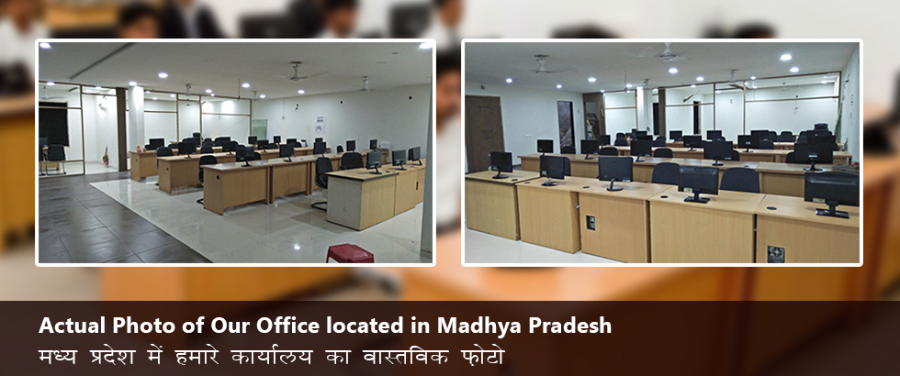
Fully Equipped Office Of Over 2000+ Square feet

Slide 16
Our Team:
Inhouse Team for Development & Designer
Self Owned Dedicated Servers
Inhouse Sales & Support Team of 43+ Persons

Slide 17
Our Stength & Capability:
In a mere Small period of 1 Year Months after becoming Authorised Principal Service Provider of IRCTC, we have appointed around 700+ IRCTC Agents Across india.

Slide 18
Services We Offer:
IRCTC Agent Registration for Railway E-Ticket Booking
AEPS – Aadhar Enabled Payment System
BBPS – Bharat Bill Payment System
Mini ATM Cash Withdrawl
Micro ATM Card Swipe Machine
AIR & Bus Ticket Booking
Mobile & DTH Recharge

Slide 19
Thank You
Visit us at
www.sionline.co.in
Call us at
8821822500
Email Us at
support@sionline.co.in
Meet Us at
Si Online Technomart Private Limited,
6, Mitra Niwas Road,
Near Rangoli,
Ratlam (MP) 457001

Slide 20
Page Keywords:
AEPS AGENT REGISTRATION
AEPS AGENT REGISTRATION | AEPS Agent Registration | aeps agent registration | aeps agent login | aadhar enabled payment system agent registration | become aeps agent | create aeps agent login id | aeps agency registration | aeps agent kaise bane | aeps license | aeps agency provider | aeps authorised agent institution | aeps authorized agent | aeps principal service provider | aeps agent registration fee | aeps agency provider | how to get aeps agency | irctc agent registration | kisok banking | bank grahak seva kendra | fastag | aeps | aadhar enabled payment system | bharat bill payment system | mini atm | money trasnfer | bbps | irctc | Pancard | uti psa pancard agent registration | multi recharge sim

